Slide 1
WG04, WG11 Ag Lab Test Data
Annual Conference 2022 Update
Modus

Slide 2
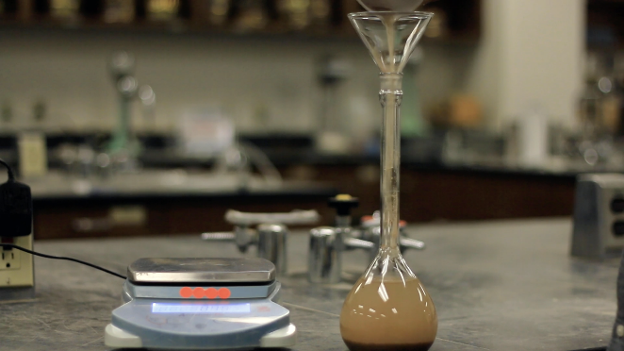
Agenda
Review of 2.0 codes, materials, status
New website, GitHub where to find stuff
New change/addition form, overview of process
OATS/OpenTeam tools review
Next Steps

Slide 3
WG04 Lab Testing
Nov 2022 Update

Slide 4
Zone/Grid Recommendations
Laboratories are faced with using over 70 data formats
_{Multiple formats}
_{Once Standardized}

Slide 5

State in 2018:
Most adopted format within the lab industry
Strong for its Controlled Vocabulary
XML format
Existing Schema: Soil, Plant, Water, Manure, Nematodes
Needed to:
Become a true “Open Source” product with a clear license
(“rules of engagement”)
Set up a process for future maintenance and progress
Evolve to other serialization formats like JSON.
Lower barriers to adoption / foundation of new AgGateway Soil Testing ADAPT Plug-in
Clean up the vocabularies, create version 2, engage the certification organizations.
Moved to
AgGateway,
did this in WG00

Slide 6
TimeLine
Past:
2018 – First Meeting (CHS sponsorship)
02/2019 – Corina introduced the initiative to laboratories
03/2019 – 2 major laboratories became AgGateway members
  A&L Great Lakes
  SGS
03/2019 – Second F2F meeting – workshop (Land O’Lakes sponsorship)
04/2019 - Both Laboratory Proficiency Programs endorsed the initiative
05/2019 – Soil Science Society of America became member
09/2019 – Brochure / flyer completed
09/2020 – Modus ownership/maintenance/license framework transfer to AgGateway
Today:
JSON schema, take steps toward a 2.0 standard

Slide 7
ISO 19156 Alignment

Slide 8
Modus v1.0 vs v2.0
v2.0 fields
  Modus 2.0 ID
    Current Modus ID
    Alt Current Modus ID
  Matrix
  Analyte
  Extraction Name
  Extraction reagents/formulation
  Extraction Ratio
  Extraction Basis
  Extraction Time
  Analyte Measurement
  Aggregation Method
  Reporting Unit, Alt Reporting Unit
  Acceptance
  Status
  Organization, Citation
v1.0 Fields
  TestID
  Soil Item
  WERA-103 Method ID*
  Extraction Method*
  Measurement Method
  Common Name
  UoM 1-8

Slide 9
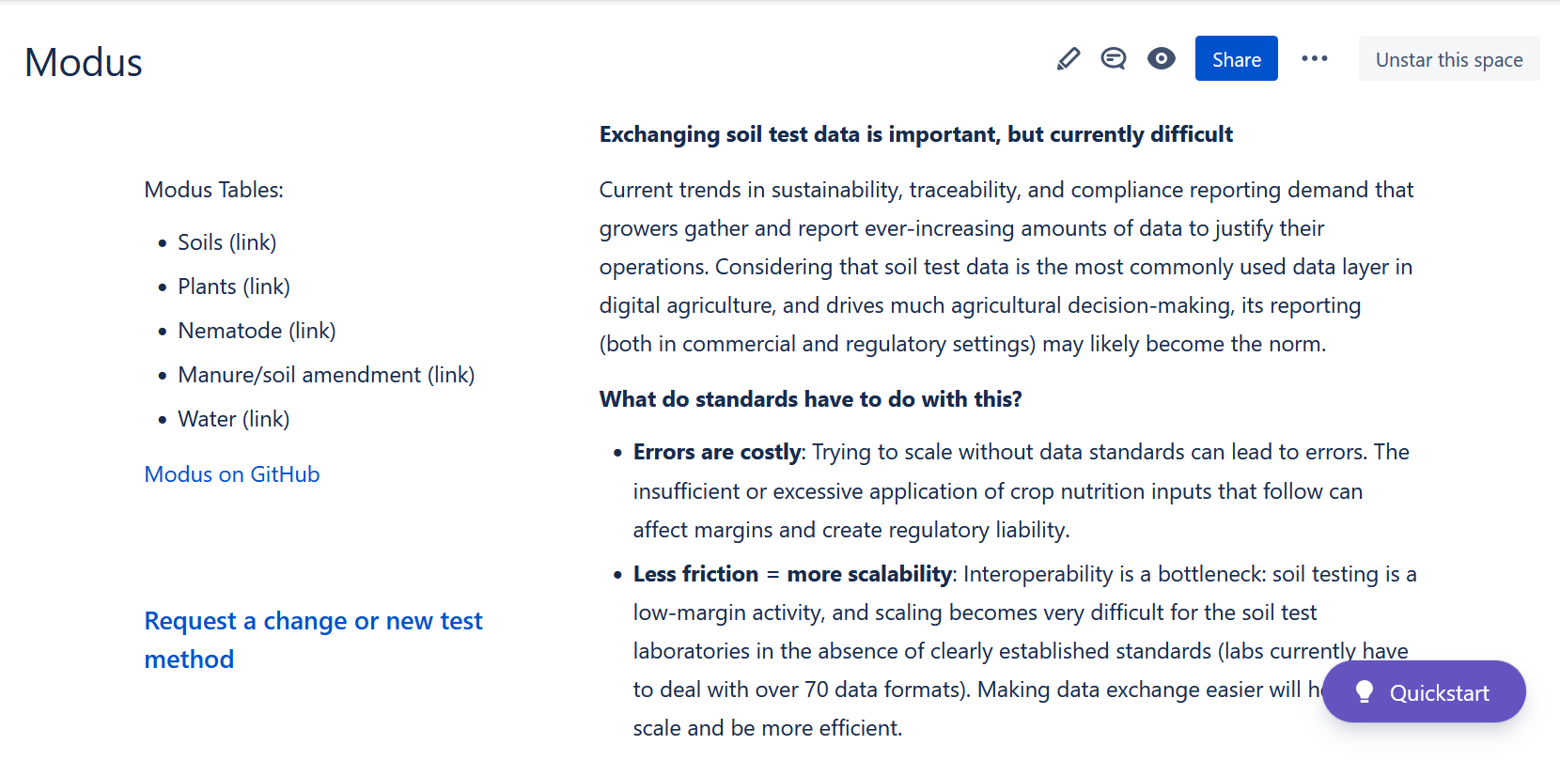
Modus Public Website

Slide 10
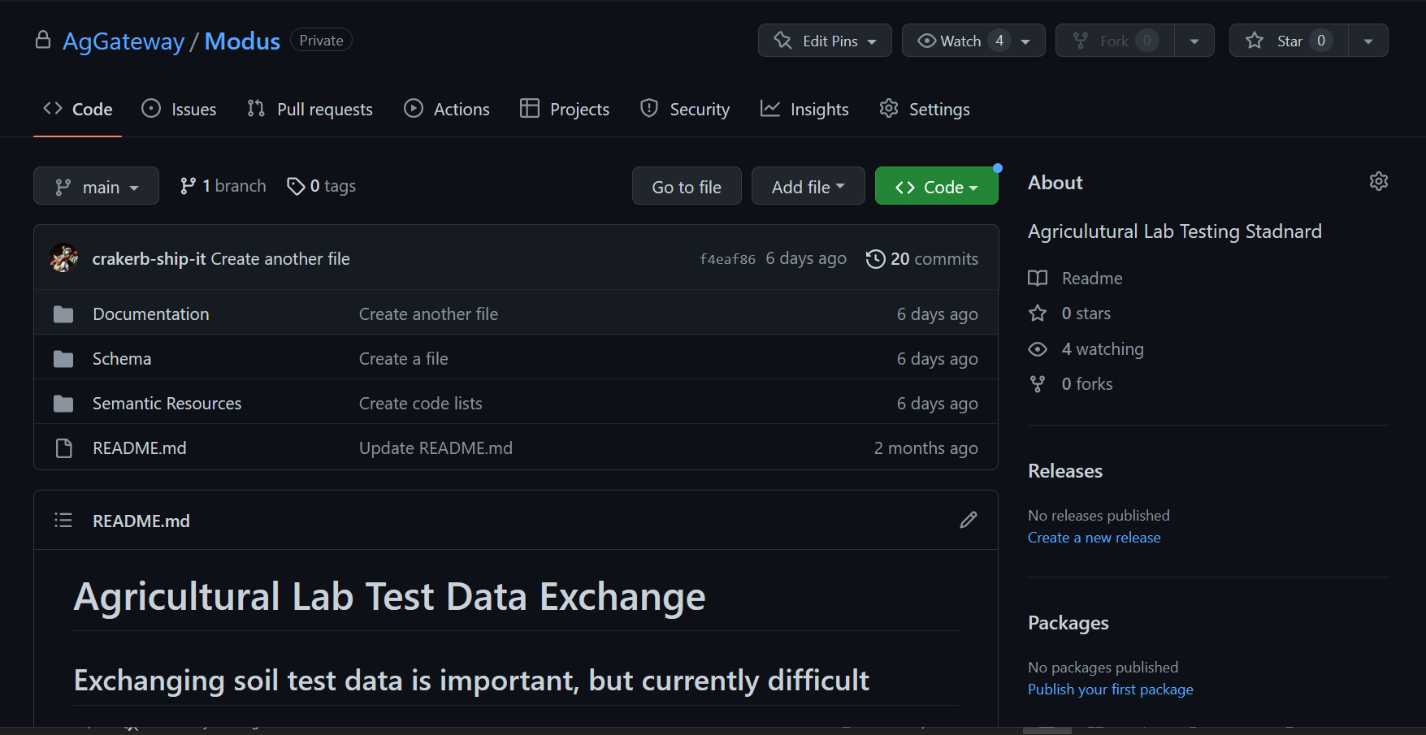
Modus GitHub

Slide 11
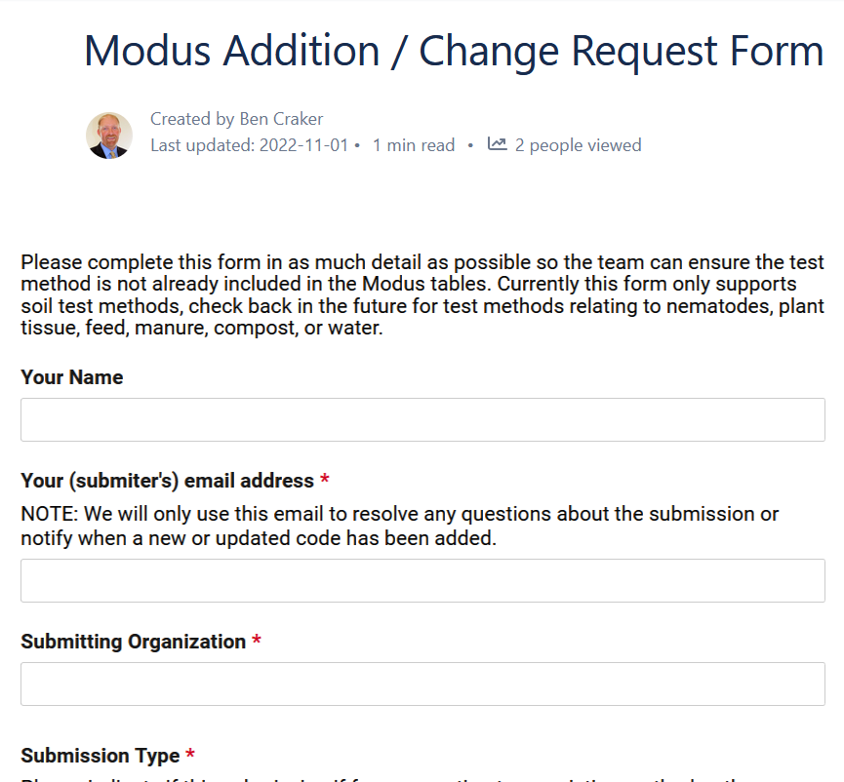
Addition / Change Form

Slide 12
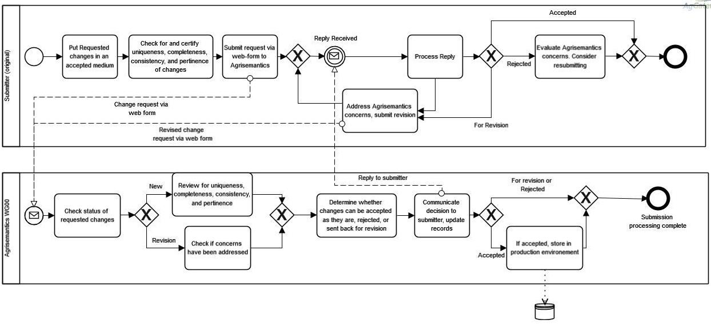
Addition / Change Process

Slide 13
OATS, OpenTeam, Farm Foundation

Slide 14
Next Steps
Driving adoption
Integrating other matrices (tissue, water, nematode, manure)
ADAPT Plugin?

Slide 15
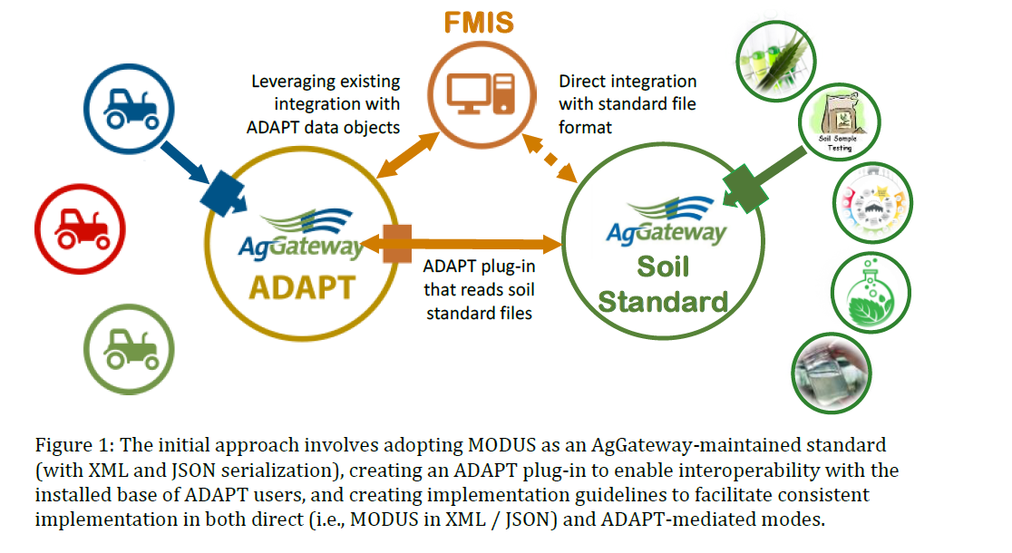
ADAPT Plugin

