Slide 1
Product Catalog
Meet Up

Slide 2
Agenda
Background / Journey
Digital Resource Public Page Updated
Github Repo
Automation
How Product Catalog can help Closed Loop
Closing

Slide 3



Background
Kick-Off April 2019 at Land O’Lakes, MN.
Product Catalog Working Team (Bayer, GROWMARK, Land O’Lakes, SmartWyre, Syngenta, Rosen’s Diversified, GS1-US. Interested - BASF, Southern States)
1
2
Purpose:
Explored current desires, needs and expectations for product catalog data, and determine interest in an industry data standard that initially addresses eCommerce.
Define “with” vs. “for” the Ag industry.
Scope - Start small – US Crop Protection, subset of products.
3
Challenges
No defined ‘product’ schema standard in Ag for eCommerce.
Lacking defined controlled vocabulary (Crops, Pests)
Existing solution is manual (labor intensive)
Outcome: Implement proof-of-concept for a product catalog within 60 days (Sept 3 to Oct 31st)
4
Outcome Proof Of Concept
Deliver IT solution to make manufacturer product information available to Distributor eCommerce solution and inform AgGateway Product “Catalog” industry standard.
Syngenta
Land O’ Lakes
Manufacturer
Distributor
eCommerce
Catalog Shema
API
OAGIS
Go-Live Oct 31st
Data fields
1- Product type
2- Product name
3- Product ID
4- Pack size
5- Product description
6- Product benefits
7- Crops
8- Pests
9- Active ingredients
10- Restricted use
Pesticide
11- Product label URL
12- Product logo URL
13- Safety data sheet URL
14- Mfg Disclaimer
5
Roadmap
US Syngenta Product Catalog API v1 available to WinField (Q4 2020 - done)
Canada Syngenta Product Catalog API v2.2 available to WinField (Q1 2022 - done)
US Syngenta Product Catalog API v2.2 available to Nutrien (Q2 2022 - done)
BASF Product Catalog API v2.3 available to WinField (Oct 2022- done)
Add GTIN, enroll other Channel Partners and Manufacturers (2023)

Slide 4
Categories of Data
Product Classification
Product Brand Name
Product Name
Product Description
Product Benefits
AI Concentrations
Marketing & Agronomic
Supply Chain
Regulatory
SKU
Package Size
Package Configuration
Standard Unit of Measure
Selling Unit of Measure
GTIN
Crops, Pests, States
Restricted Use Pesticide
Link to Safety Data Sheet
Product Label, Product Logo
Legal Disclaimer

Slide 5
Value of Product Catalog
Improve the Customer Experience
Empowers customers to make better informed decisions and gives them the confidence they are buying the product they want.
Makes it easier for customers to search for products and place an online order.
Enables the delivery of a rich and consistent experience to your customers
Omnichannel Experience
Customers expect a similar experience from multiple sources including E-commerce, Website, Mobile Apps, and Digital Ag Platforms.
Improve Staff Productivity
Reduction in the time and cost involved for Marketing and E-commerce teams to manually maintain product information at an increasing scale across manufacturers.

Slide 6
Expanded Use Cases
V2.2 Requirements
Product Mixing Instructions
Common Use Rate (acres/unit)
Minimum Water Volume (ground)
Minimum Water Volume (aerial)
Registration Status (Registrar, Registration Identifier, effective dates)
Mode of Action
Regional Availability
V2.x Requirements
SEO Product Name
SEO Product Description
SEO Key Words
Attachment
Product Alternate Image
Marketing Video File
Supplemental Label URL
Product Sell Sheet URL
Product Image
Environmental Condition /Application Timing
Weather Timing (Wind Speed, Min /Max Temp, Rainfast)
Soil Types (Course, Fine)
Application Rate (min / max rates)
Top Tank Mixes
1) Extend to new geography: Canada
2) Additional Label data: Agronomic

Slide 7
Product Catalog & Closed Loop – Data View
Manufacturer
Distributor
Retailer
Field Operator
Farmer
Product Catalog
Agronomic
R&D Product Spec
Packaging
Warehouse Locations
Manufacturing Batch/ Lot
E-Commerce
Shipments with Lot/Batch
Agronomic Recommendations
Sales
Shipments with Lot/Batch
Planning
Receipts with Lot/ Batch
Finance
Assets
Asset Utilization
Work Order
Product Identification with Lot /Batch
Work Record Datasets (CN, Seed, CP, Harvesting)

Slide 8
Synergy
Manufacturer
POST
/shippediteminstance
GET
/setupfiles
Retailer Systems
Product Setup
Catalog API
Co-operative/ Distributor
ShippedIemInstance API
Tractor Display
Orders
Shipments
GET
/catalog
GET
/catalog
POST /plantingworkorder
GET
/shippediteminstance
Reference Data API
FMIS

Slide 9
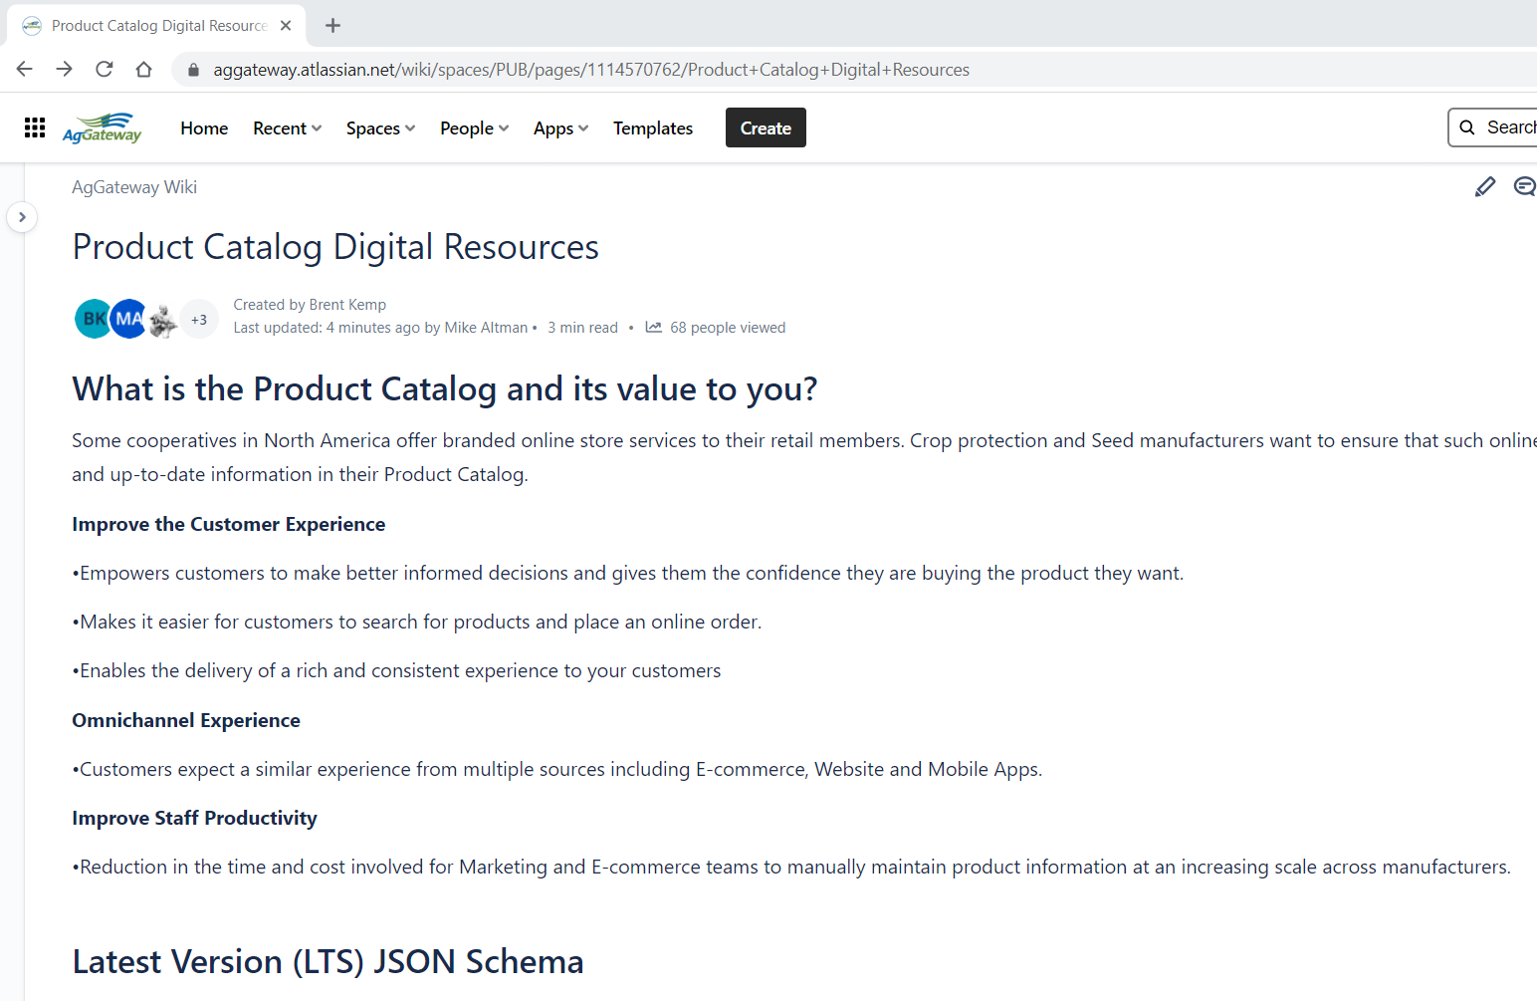

Digital Resource Center Update
Digital Resource Public Page
  Value of Product Catalog
  Latest Version (LTS) JSON Schema
  Solution Architecture for Partner Consideration
  Open API Definition
  DDL for Staging Tables
  Data Dictionary
  Controlled Vocabularies

Slide 10
Version History
AgGateway Version | OAGIS Release | Status | Scope
1.0 | 10.6 | 11/2020 | MVP from 6/2019
2.0 | 10.7 | 6/2021 | Removed extensions, added superseded by item, brand, product name, and variety
2.2 | 10.7.3 | 4/5/2022 | Added new OAGIS components; i.e., Registration Status, Application Instructions Environmental conditions to address application timing
2.3 | 10.8.1 | 6/8/2022 | Substance – breakdown of composition of product, identify seed treatment.

Slide 11
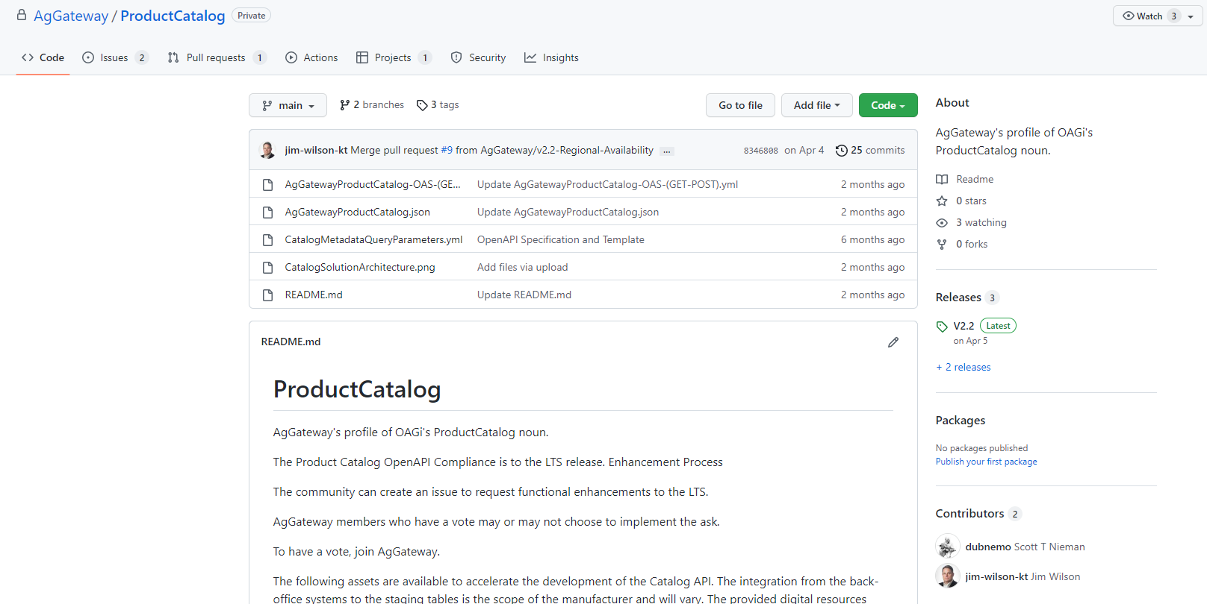
Github Repo

Slide 12
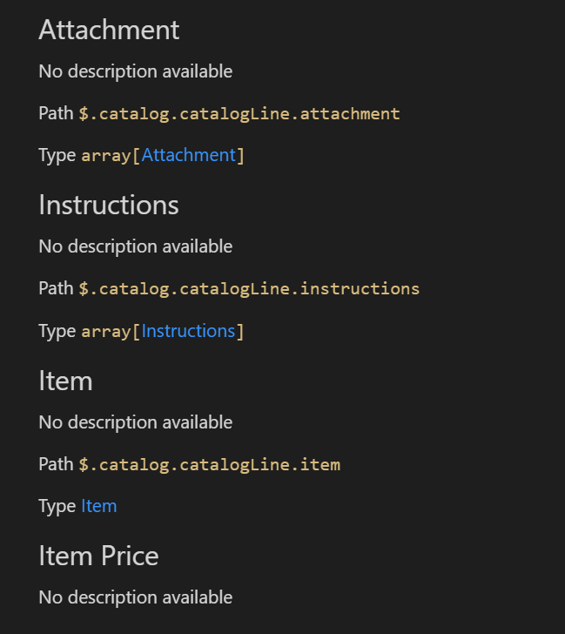
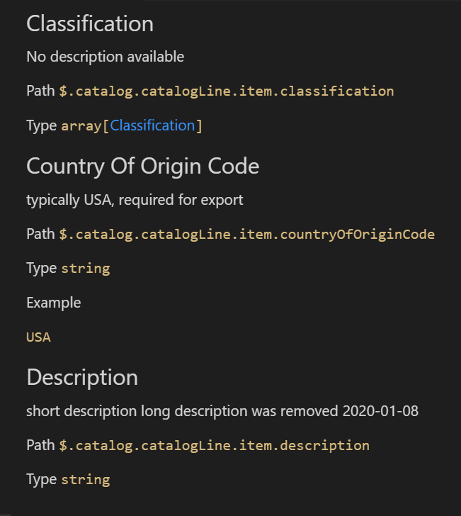
Data Dictionary

Slide 13
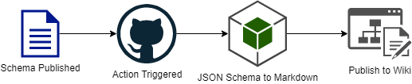
Automation
Exploring automating data dictionary (javascript) workflow to incorporate into Digital Resource Center.

Slide 14
Backlog
Update XLSX mapping specification to the WinField United contributed staging tables data model/database definition language (DDL), which probably is still dating back to v1.0
Upload of the data dictionary that Syngenta compiled
Update the Public Confluence page for the product catalog OpenAPI marketing and technical information perhaps with links to the OpenAPI yaml file and data dictionary (#2).
GitHub repo is private. That is where the YAML, mapping specifications, and DDL reside. Engage AgGateway Leadership of these digital resources to AgGateway members only. Should this be opened to non-members?

Slide 15
Next Steps & Closing
Explore opportunities with other Manufacturers and Channel Partners
Explore Power of Connections Opportunities (In-Field Identification, AGIIS, Other)
Questions? Contact Scott Nieman, Joe Gifford
We are seeking firm commitments from implementation partners to bring this vision to life!

Slide 16
Backup Slides

Slide 17
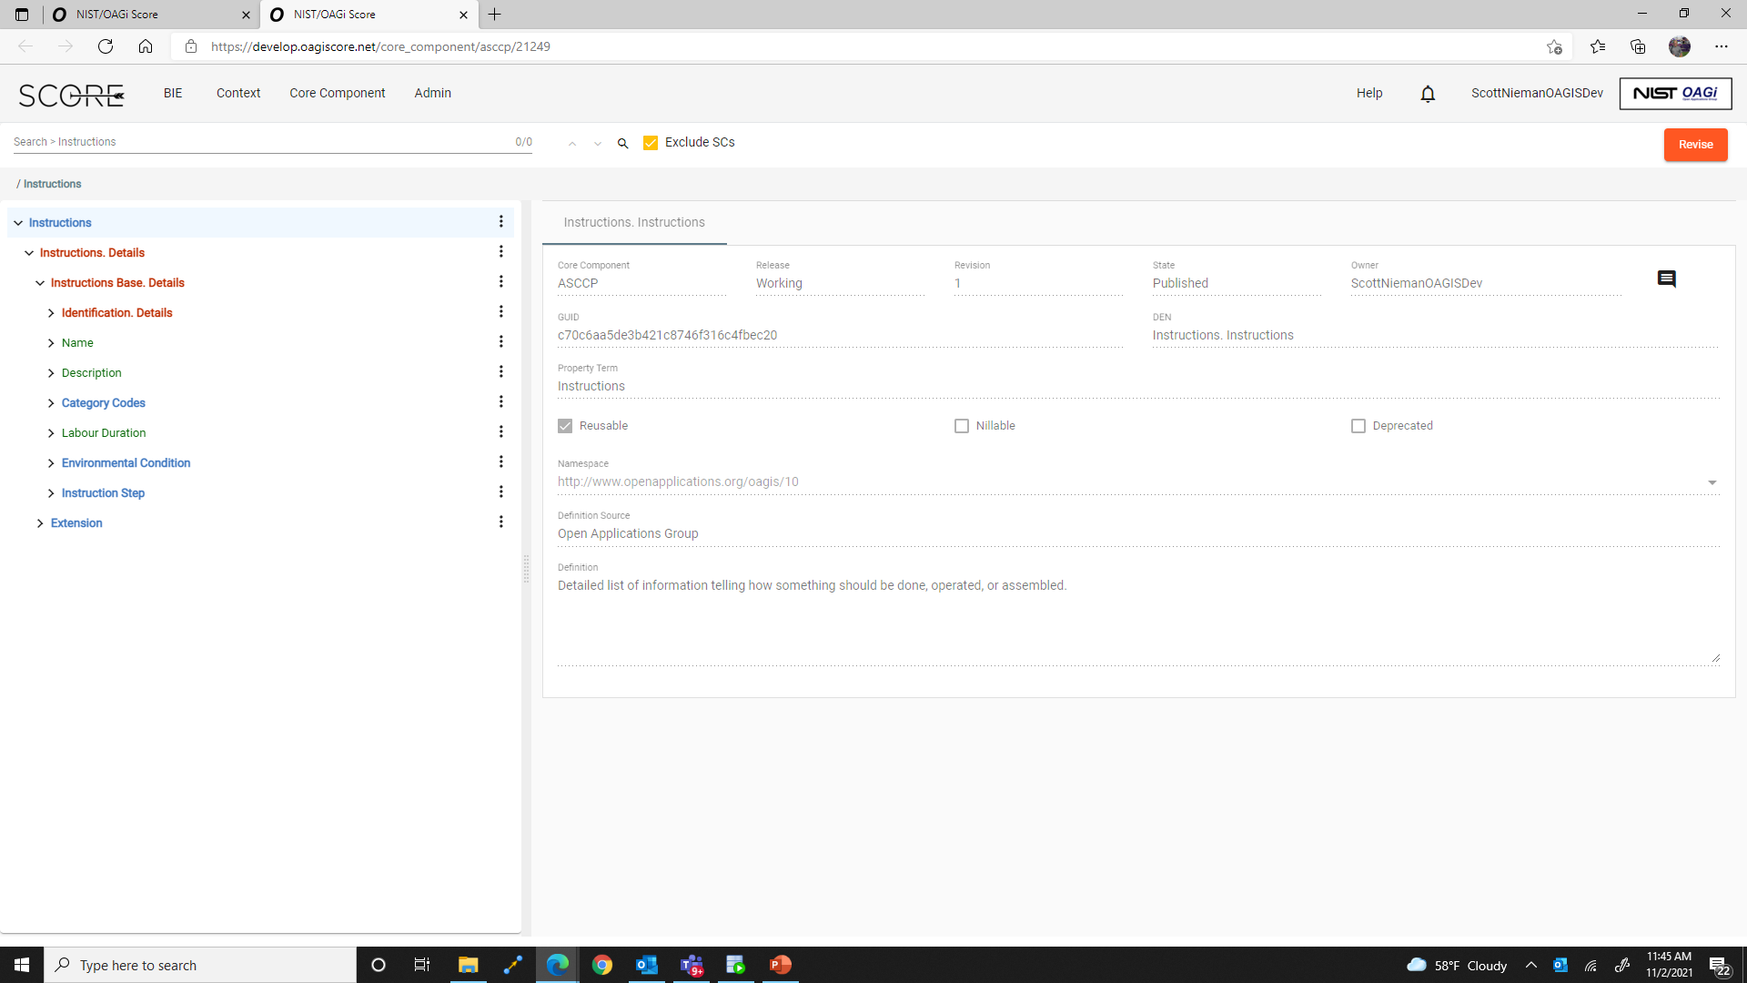
V2.2

Slide 18
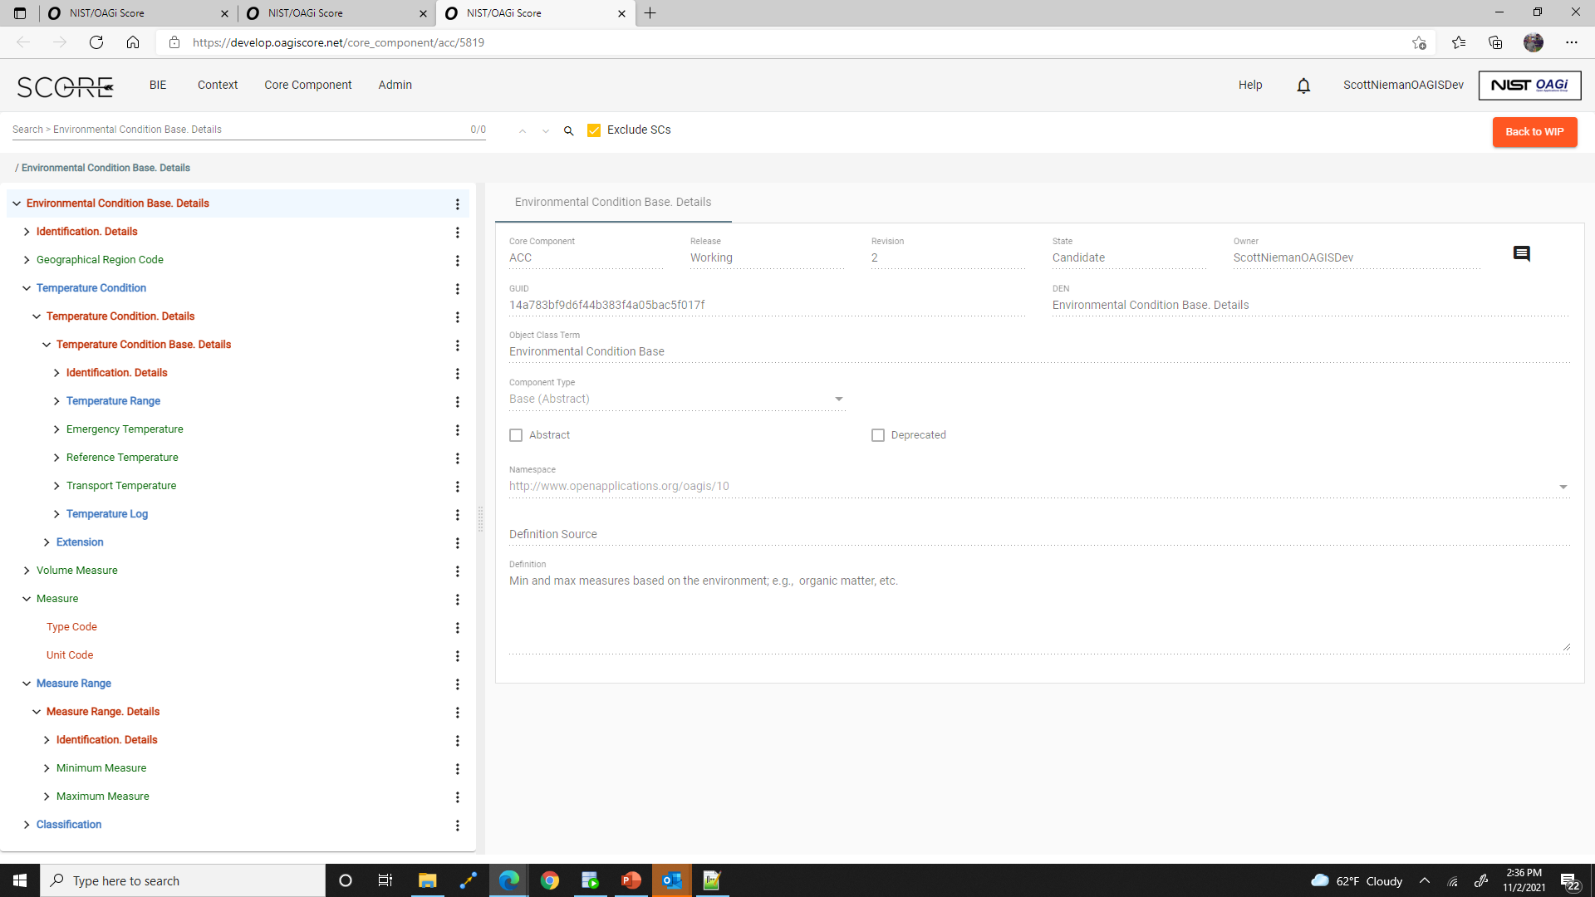
V2.2

Slide 19
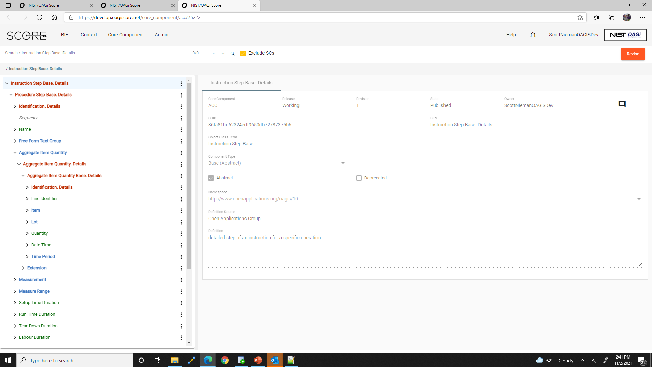
V2.1
V2.2

Slide 20
Application Instructions JSON Path
.catalogLine.instructions[].typeCode=Application
.catalogLine.instructions[].name
.catalogLine.instructions[].description
--
-- OK to Spray criteria
--
.catalogLine.instructions[].environmentalCondition[].geographicalRegionCode[].typeCode
.catalogLine.instructions[].environmentalCondition[].geographicalRegionCode[].content
.catalogLine.instructions[].environmentalCondition[].geographicalRegionCode[].listIdentifier
.catalogLine.instructions[].environmentalCondition[].geographicalRegionCode[].listAgencyIdentifier
.catalogLine.instructions[].environmentalCondition[].temperatureCondition.temperatureRange.minimumTemperature
.catalogLine.instructions[].environmentalCondition[].temperatureCondition.temperatureRange.maximumTemperature
.catalogLine.instructions[].environmentalCondition[].measure[].typeCode
.catalogLine.instructions[].environmentalCondition[].measure[].content
.catalogLine.instructions[].environmentalCondition[].measureRange.typeCode
.catalogLine.instructions[].environmentalCondition[].measureRange.identifier.content
.catalogLine.instructions[].environmentalCondition[].measureRange.identifier.schemeAgencyIdentifier
.catalogLine.instructions[].environmentalCondition[].measureRange.minimumMeasure
.catalogLine.instructions[].environmentalCondition[].measureRange.maximumMeasure
.catalogLine.instructions[].environmentalCondition[].classification.codeListValue.code
.catalogLine.instructions[].environmentalCondition[].classification.codeListValue.definition
--
-- If OK to Spray then
--
.catalogLine.instructions[].instructionStep[].typeCode
.catalogLine.instructions[].instructionStep[].sequence
.catalogLine.instructions[].instructionStep[].name
.catalogLine.instructions[].instructionStep[].description
.catalogLine.instructions[].instructionStep[].note
.catalogLine.instructions[].instructionStep[].measureRange[].typeCode
.catalogLine.instructions[].instructionStep[].measureRange[].identifier.content
.catalogLine.instructions[].instructionStep[].measureRange[].identifier.schemeAgencyIdentifier
.catalogLine.instructions[].instructionStep[].measureRange[].minimumMeasure
.catalogLine.instructions[].instructionStep[].measureRange[].maximumMeasure
V2.1
V2.2
V2.1
V2.2

Slide 21
Application Instructions JSON Path (close-up)
.catalogLine.instructions[].typeCode=Application
.catalogLine.instructions[].name
.catalogLine.instructions[].description
--
-- OK to Spray criteria
--
.catalogLine.instructions[].environmentalCondition[].geographicalRegionCode[].typeCode
.catalogLine.instructions[].environmentalCondition[].geographicalRegionCode[].content
.catalogLine.instructions[].environmentalCondition[].geographicalRegionCode[].listIdentifier
.catalogLine.instructions[].environmentalCondition[].geographicalRegionCode[].listAgencyIdentifier
.catalogLine.instructions[].environmentalCondition[].temperatureCondition.temperatureRange.minimumTemperature
.catalogLine.instructions[].environmentalCondition[].temperatureCondition.temperatureRange.maximumTemperature
.catalogLine.instructions[].environmentalCondition[].measure[].typeCode
.catalogLine.instructions[].environmentalCondition[].measure[].content
.catalogLine.instructions[].environmentalCondition[].measureRange.typeCode
.catalogLine.instructions[].environmentalCondition[].measureRange.identifier.content
.catalogLine.instructions[].environmentalCondition[].measureRange.identifier.schemeAgencyIdentifier
.catalogLine.instructions[].environmentalCondition[].measureRange.minimumMeasure
.catalogLine.instructions[].environmentalCondition[].measureRange.maximumMeasure
.catalogLine.instructions[].environmentalCondition[].classification.codeListValue.code
.catalogLine.instructions[].environmentalCondition[].classification.codeListValue.definition
--
V2.1
V2.2
Organic matter
Wind Speed
Growth stage
Soil Texture

Slide 22
Application Instructions JSON Path (cont)
--
-- If OK to Spray then
--
.catalogLine.instructions[].instructionStep[].typeCode
.catalogLine.instructions[].instructionStep[].sequence
.catalogLine.instructions[].instructionStep[].name
.catalogLine.instructions[].instructionStep[].description
.catalogLine.instructions[].instructionStep[].note
.catalogLine.instructions[].instructionStep[].measureRange[].typeCode
.catalogLine.instructions[].instructionStep[].measureRange[].identifier.content
.catalogLine.instructions[].instructionStep[].measureRange[].identifier.schemeAgencyIdentifier
.catalogLine.instructions[].instructionStep[].measureRange[].minimumMeasure
.catalogLine.instructions[].instructionStep[].measureRange[].maximumMeasure
V2.1
V2.2

Slide 23
Mixing Instructions JSON Path
.catalogLine.instructions[].typeCode=Mixing
.catalogLine.instructions[].name
.catalogLine.instructions[].description
.catalogLine.instructions[].instructionStep[].typeCode
.catalogLine.instructions[].instructionStep[].sequence
.catalogLine.instructions[].instructionStep[].name
.catalogLine.instructions[].instructionStep[].aggregateItemQuantity[].item.identifier
.catalogLine.instructions[].instructionStep[].aggregateItemQuantity[].item.name
.catalogLine.instructions[].instructionStep[].aggregateItemQuantity[].quantity.unitCode
.catalogLine.instructions[].instructionStep[].aggregateItemQuantity[].quantity.content
V2.1

Slide 24
Controlled Vocabularies for Application Instructions
Geographic Region Code
Soil Texture (coarse, fine…)
Growth Stage
Agency Reference

Slide 25
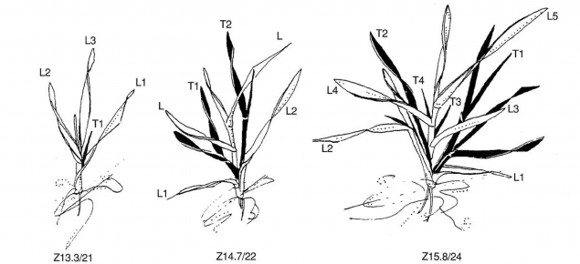
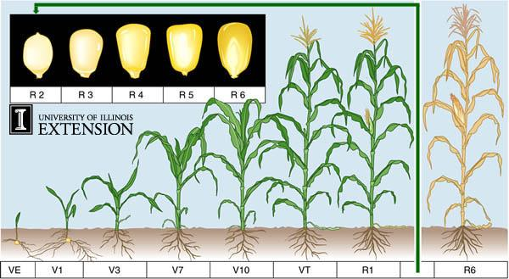
Growth Stage – Cite your sources
Zadoks growth scale | Agriculture and Food
Iowa State University
Purdue University

Slide 26
Proposed Timelines
Standard & Guidelines review of v2.1 catalog schema
Delivery of Syngenta Canada API with WinField (Deliver Q1 2022)
On-board 2nd Manufacturer (BASF – Q1 2022)
On-board 2nd Distributor (TBA – Q1 2022)
On-board 3rd Manufacturer (TBA – 2022)
Explore opportunities with other manufacturers and Channel Partners (2022)
Explore Power of Connections Opportunities (In-Field Identification, AGIIS, Other)

