Slide 1
PMC Review
November 2022

Slide 2
Agenda
PMC Organizational Overview
Current Working Group Overview
Recently Completed Digital Resources
Looking Forward
Other Issues & Opportunities

Slide 3
PMC Groups
Found within Portfolio Management Center
Subcommittees
Strategic in nature, providing longer term guidance in a subject area
Working Groups
Shorter in duration, delivering defined digital resources
Individuals affirmatively join a Working Groups via Join Form
Company participation must be confirmed by AgGateway primary contact per IP policy

Slide 4
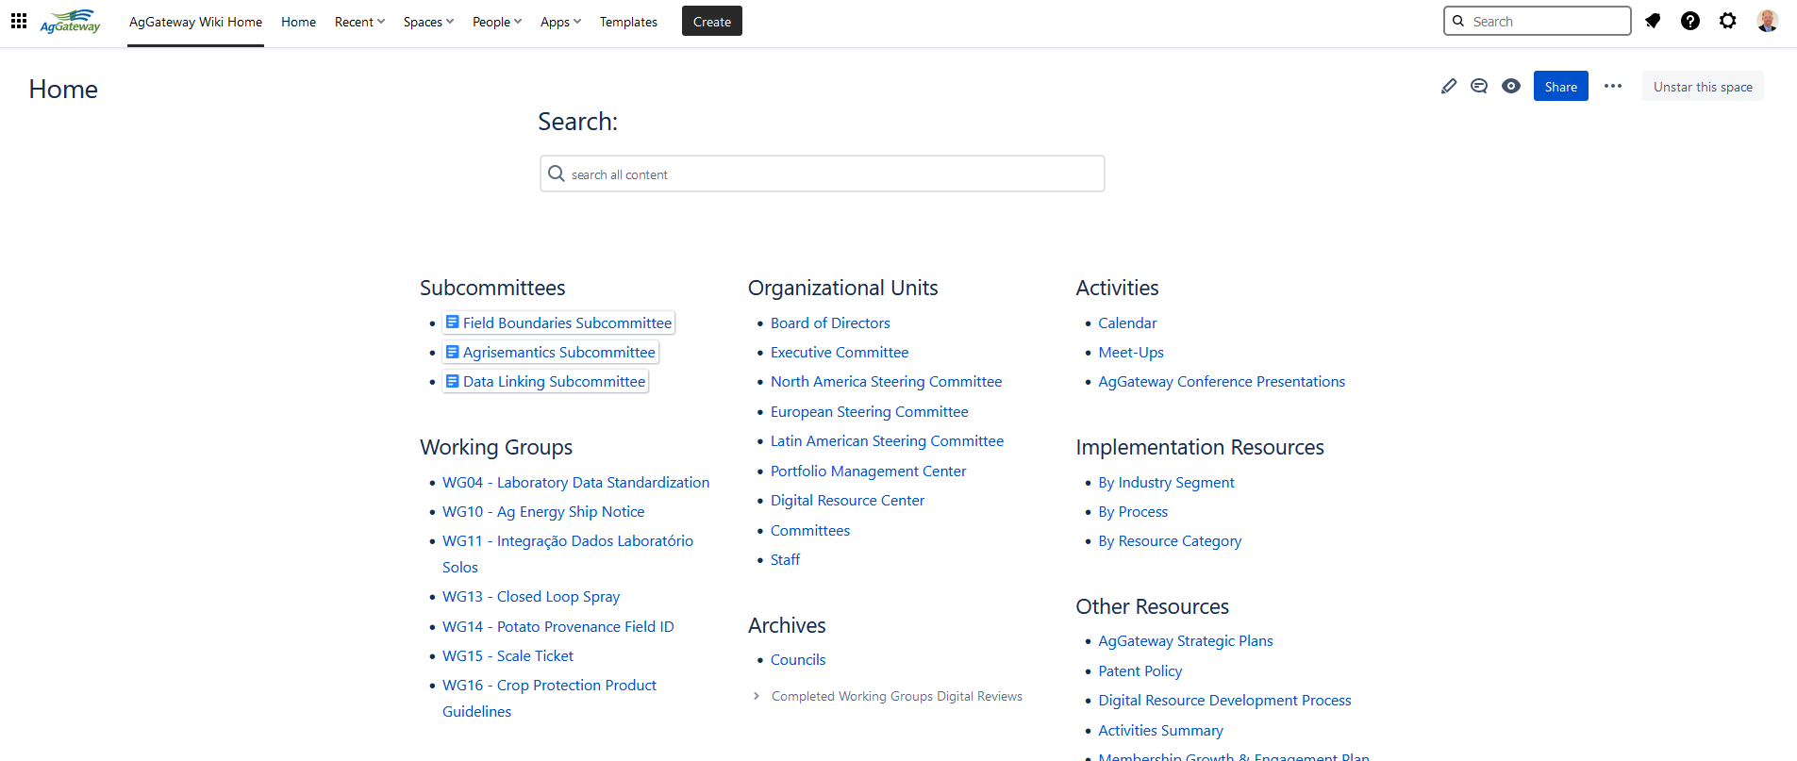
Where to Find Stuff on the Wiki
Notes:
WG links all go to home page for that WG with same layout/sectins

Slide 5
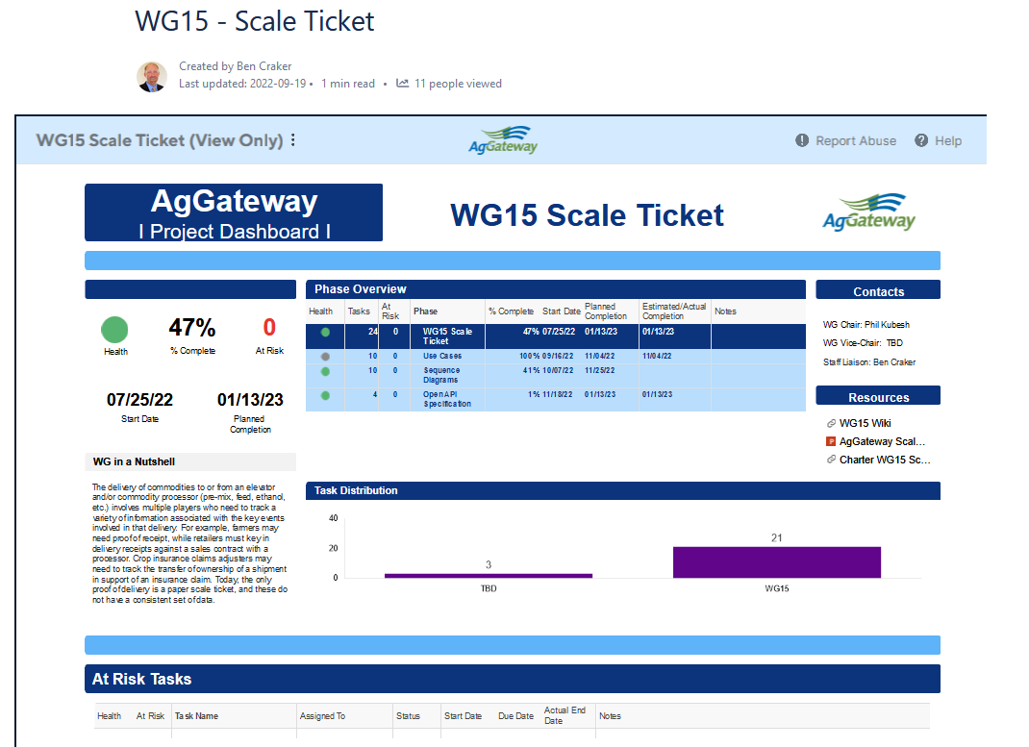
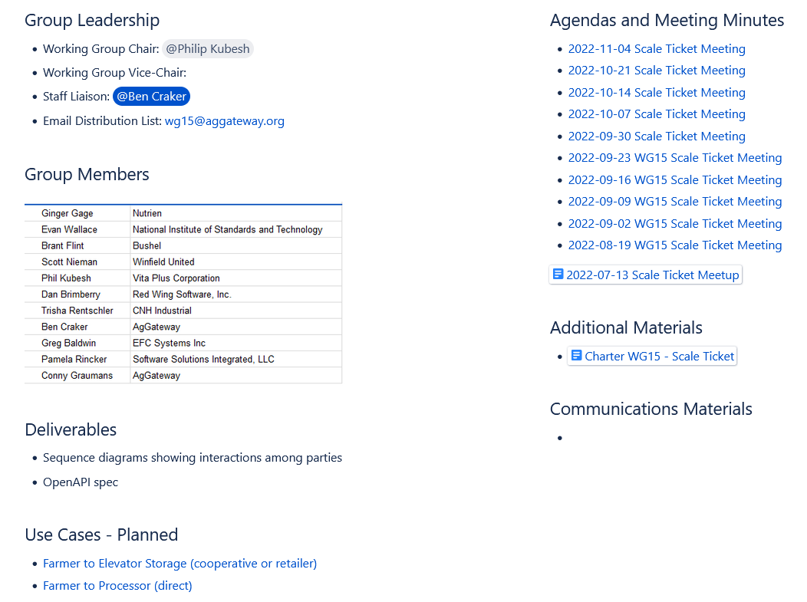
WG Status Pages Feedback
Notes:
Who has looked at one
What do people want to see on these pages
What is valuable to track WG progress

Slide 6
The Subcommittees
Agrisemantics Subcommittee
Data Linking Subcommittee
Field Boundaries Subcommittee
Portfolio Subcommittee | Working Group
Advises working groups under the auspices of the PMC. | Provides requirements and feedback to the Subcommittee.
Coordinates a long-term series of working group activities. | Executes the development of a clearly defined package of digital resources.
Develops frameworks and guidelines. | Develops digital resources.
Existence is long-term; greater than 12 months. | Existence is short-term; 12-16 weeks.
Has an approved charter and reports to the Portfolio Management Center. | Has an approved charter and reports to the Portfolio Management Center.
Limited in number. | No arbitrary limit in number.
Members join via the “Join a Working Group” Smartsheet form. | Members join via the “Join a Working Group” Smartsheet form.
Works at the strategy level. | Works at the project level.

Slide 7

Agrisemantics Subcommittee
Business Value: Helps companies and organizations to analyze and use data more efficiently and precisely to solve customer problems though agricultural definitions and semantics infrastructure
Areas of Oversight:
Glossary of Agricultural Terms
Controlled Vocabularies & Units of Measure
Common model to express geo-political context
Deliverables:
Controlled vocabularies for soil testing lab data
Controlled vocabularies for an ADAPT Cotton Plugin.
Working with the Data Linking Subcommittee
Providing input to the Field Boundaries Meet Ups
Chair: Andres Ferreyra (Syngenta)
Staff Liaison: Jim Wilson
Member Companies:
SSI
Enterprise Ag Strategies
National Crop Insurance Services
NIST
Syngenta
Wilbur-Ellis
Notes:
Wednesday @ 9:00

Slide 8
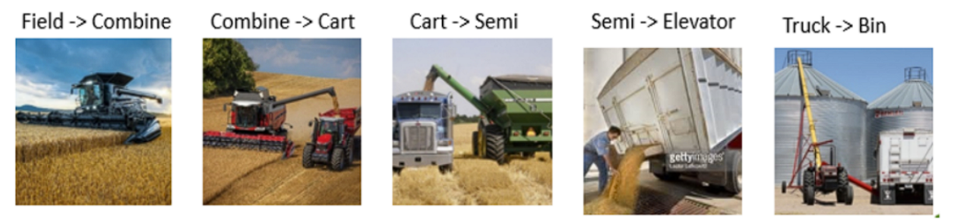
Data Linking Subcommittee
Purpose
Allows awareness and linkage of related agricultural data
Helps farmers who work with more than one data repository
Enables farmers to share their data to gain insights
Assist in product recalls, traceability, and consumer confidence
Deliverables:
Framework and processes for defining metadata repositories
Guiding principles for in-field data collection
Controlled vocabularies (with Agrisemantics)
Guidance to tracing critical tracking events and data repositories for the “Proof of Delivery of Grain” use case
Co-Chair: Joe Tevis (Vis4Ag)
Co-Chair: Scott Nieman (Land O’Lakes)
Staff Liaison: Ben Craker
Member Companies:
Land O'Lakes
NIST
SSI
Syngenta
Vis Consulting
Also coordinating with AEF
Notes:
Tuesday @ 2:00

Slide 9
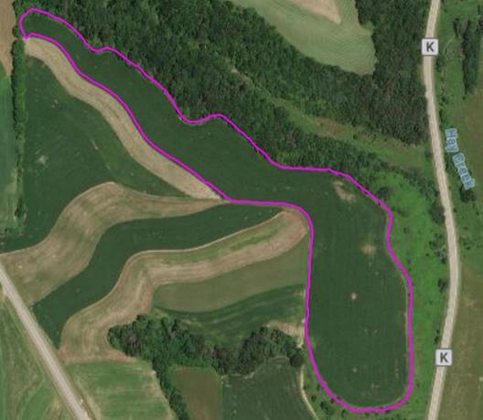
Field Boundaries Subcommittee
Purpose
An unambiguous, core definition of a field and field boundary that can serve as the basis for different business use cases, can reduce effort and confusion across the value chain
Preserving the meaning of that core definition, while adding relative meaning for different use cases
Enable farmers to share their field data without having to learn a multitude of terms and meanings
Assist in traceability efforts
Chair: TBD
Staff Liaison: Jeremy Wilson
Member Companies:
Nutrien
Ceres Solutions
Growmark, Inc.
Winfield United
Raven Industries
Deliverables:
This subcommittee will review the uses cases developed during the Field Boundary meet ups to determine the working groups needed to develop Global Field Boundary Standards. The subcommittee will review In-Scope tasks with the Portfolio Manager quarterly to ensure timely progress.
Notes:
Wednesday at 8:00

Slide 10
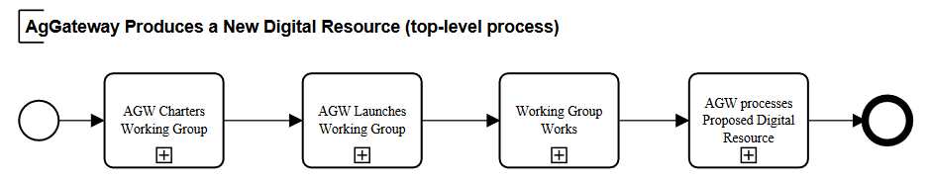
Current Working Groups
AgGateway Digital Resource Development Process

Slide 11




AgGateway Working Groups in the Value Chain
WG01 In-Field Product ID Seeding Pilot
  Seed list from retailer to farmer/planter controller
WG03 Product Catalog
  Common information on products for ecommerce
WG04 Ag Lab Data
  Standardized data from lab test
WG05 Mix Ticket
  Work record from product mixing operation
WG06 Farm Inputs: Reference Data
WG07 Farm Inputs: Work Order, Work Record
WG08 In-Field Product ID ADAPT Plugin
WG09 Linked Data
WG10 Ag Energy Ship Notice
WG11 LATAM Soil Data
WG12 PAIL
WG13 Closed Loop Spray
WG14 Potato Provenance
WG15 Scale Ticket
WG16 Crop Protection Product Guidelines
WG17 Field Boundary Terms & Definitions
WG18 Crop Nutrition 3rd Party Warehouse Mgmt
WG19 ADAPT Serialization
WG20 TRU and CTE Modeling
Input manufacturer
Input distribution/retail
Farm
Field operations
Processor
WG15
WG10
WG07
WG03
WG17
WG06
WG18
WG09
WG16
WG19
WG14
WG12
WG08
WG05
WG20
WG01
WG04
WG13
WG11
Notes:
Hexagons are the bestagons

Slide 12

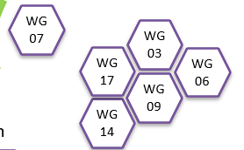
Core Elements Across Value Chain
WG03 Product Catalog
  Common information on products for ecommerce
  May be leveraged for product identification in different areas of value chain
WG06 Farm Inputs: Reference Data
  Crop protection class and semantic models
WG07 Farm Inputs: Work Order, Work Record
  Crop protection reference data model
WG09 Linked Data
  Metadata standard to be able to find and use data sets
WG14 Potato Provenance
  Uniquely identified fields
WG17 Field Boundary Terms & Definitions
  Terms, definitions and use cases for fields, field boundaries

Slide 13

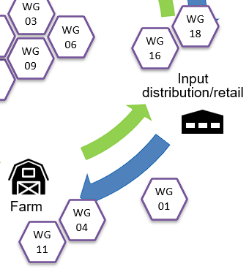
Input Manufacture, Distribution to Farm
WG01 In-Field Product ID Seeding Pilot
  Seed list from retailer to farmer/planter controller
    Seed variety, lot, batch, treatment
WG04 Ag Lab Data
  Standardized data from labs
WG11 LATAM Soil Data
  Latin America soil test data gap check of WG04
WG16 Crop Protection Product Guidelines
  Consistent updates for crop protection products in reference
WG18 Crop Nutrition 3rd Party Warehouse Management
  Messages to enable more efficient inventory and invoicing for crop nutrition

Slide 14
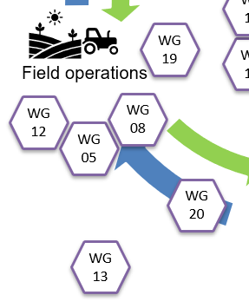
Field Operations
WG05 Mix Ticket
  Work record from product mixing operation
WG08 In-Field Product ID ADAPT Plugin
  ADAPT plugin to move seed data to FMIS/MICS
WG12 PAIL
  Irrigation standard for both sensor inputs and irrigation work records
WG13 Closed Loop Spray
  Round trip documentation from crop protection product recommendation to as-applied
WG19 ADAPT Serialization
  Standardized serialization format based on ADAPT standard schema
WG20 TRU and CTE Modeling
  Modeling traceability events and
  containers

Slide 15

Processor and Input Manufacturing
WG10 Ag Energy Ship Notice
  Electronic ship notice and invoice for ag fuels
WG15 Scale Ticket
  Electronic, standardized scale ticket

Slide 16
AgGateway Working Groups in the Value Chain
Input manufacturer
Input distribution/retail
Farm
Processor
Field operations
Complete, ready for implementation
WG01 In-Field Product ID Seeding Pilot
  Seed list from retailer to farmer/planter controller (ShippedItemInstance)
WG03 Product Catalog
  Common information on products for ecommerce
WG05 Mix Ticket
  Work order/record from product mixing
WG06 Farm Inputs: Reference Data
WG07 Farm Inputs: Work Order, Work Record
WG08 In-Field Product ID ADAPT Plugin
WG09 Linked Data (DatasetMetadata)
Wrapping Up:
  WG04 Ag Lab Data
  WG11 LATAM Soil Data
  WG12 PAIL
  WG16 Crop Protection Product Guidelines
Active or Starting Up:
  WG10 Ag Energy Ship Notice
  WG13 Closed Loop Spray
  WG14 Potato Provenance
  WG15 Scale Ticket
  WG17 Field Boundary Terms & Definitions
  WG18 Crop Nutrition 3rd Party Warehouse Management
  WG19 ADAPT Serialization
  WG20 TRU and CTE Modeling
WG15
WG10
WG07
WG03
WG18
WG17
WG06
WG09
WG16
WG14
WG19
WG12
WG08
WG05
WG20
WG01
WG04
WG13
WG11

Slide 17
Recently Digital Resources: ready to Implement

Slide 18
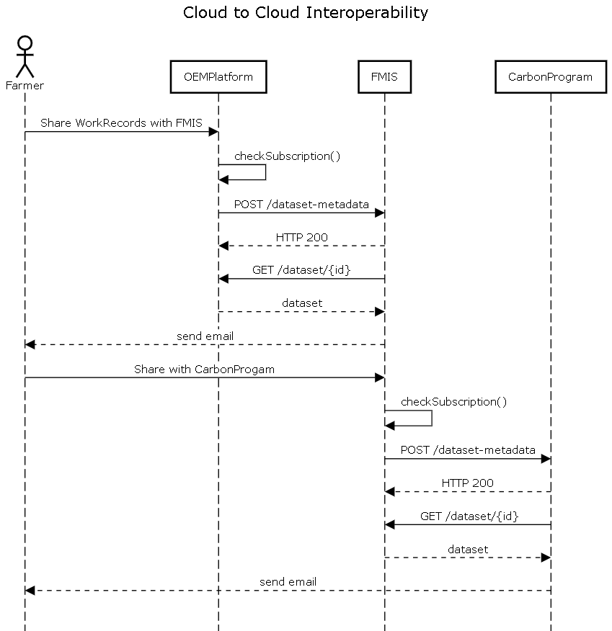
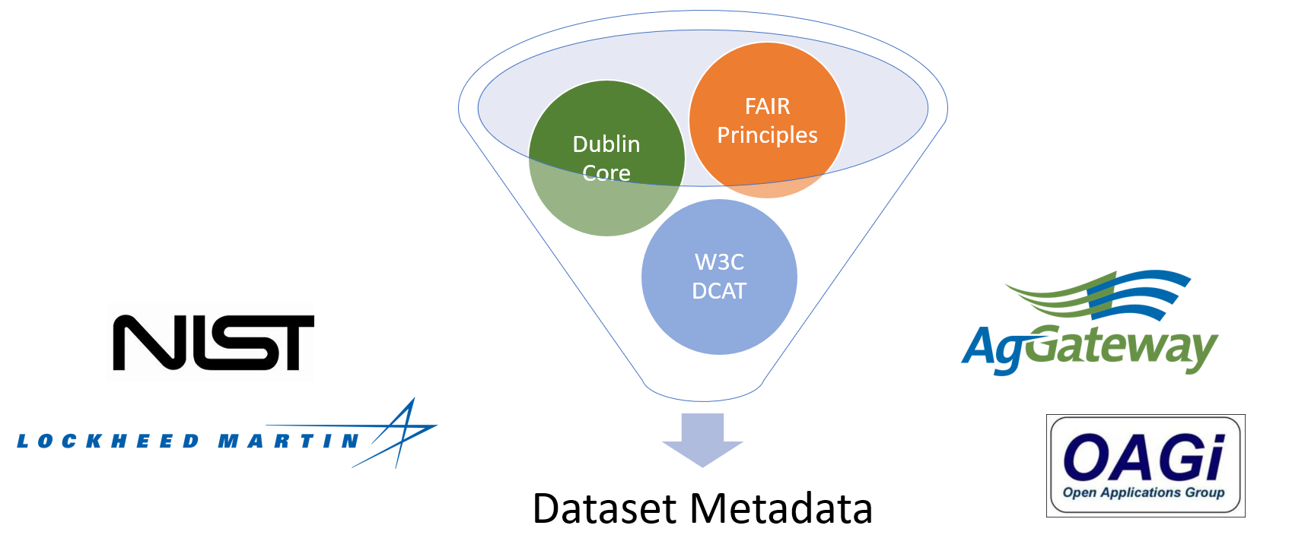
Notable Recent WG Digital Resources
DatasetMetadata (WG09)
A farmer can share the raw dataset uploaded to an OEM cloud with an FMIS partner, and further sharing of the processed dataset with a Carbon Program platform partner.
In each case, the Dataset Metadata provides the necessary content as the notification message that enables the recipient to retrieve that shared dataset.

Slide 19
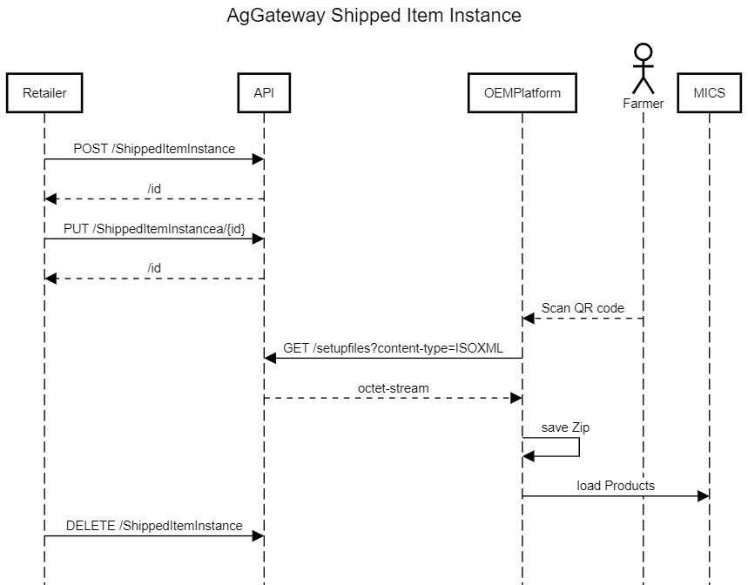
Notable Recent WG Digital Resources
ShippedItemInstance (WG01)
Retailer provides a ShippedItemInstance file to the Farmers FMIS. This is used to create the Setup data/prescription file(s) for the farmers field operations. Only the products the farmer purchased are sent to the tractor display. If using ISO11783, the product list includes unique identifiers in a LinkList file that can be used to provided more product information such as variety, lot, batch, and seed treatment for improved traceability.

Slide 20
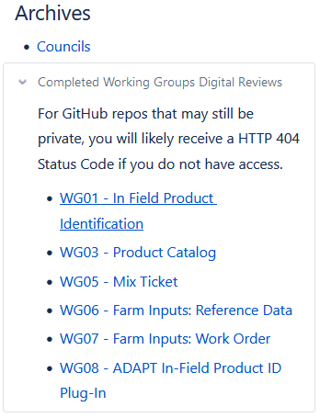
Where to Find Digital Resources
Many WG’s now using GitHub
  Finalizing license
  Finalizing access
  DRC will be able to monitor and support future revisions
Some projects have their own public Wiki space
Home page has Archive of PMC to DRC handoff documents

Slide 21
Individual WG Detail Slides

Slide 22
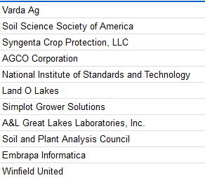
WG04 Ag Laboratory Data Standardization
Business Value:
Automated test data management to improve labs’ efficiency and enable increased sample throughput.
Scope: Soil initially, Water, Plant Tissue, Manure to follow
Deliverables:
Updated MODUS Tables
Observation codes
XML Schema
Status: Finalizing MODUS 2.0 tables for soils, incorporating plants, nematodes, manure/compost, water
Chair: Open
Staff Liaison: Ben Craker
Member Companies:

Slide 23
WG11 LATAM Soil Test Data Standardization
Business Value:
Automated test data management to improve labs’ efficiency and enable increased sample throughput. Partnering with WG04 to gap check and add/edit Modus tables for tropical soils and LATAM specific test methods
Scope: Soil initially, Water, Plant Tissue, Manure, etc. to follow
Deliverables:
Updated MODUS Tables
Observation codes
XML Schema
Status: Finalizing MODUS 2.0 tables for soils, incorporating plants, nematodes, manure/compost, water
Chair: Ronaldo Oliviera (EMBRAPA)
Staff Liaison: Loyola
Member Companies:

Slide 24
WG10 Ag Energy Ship Notice
Business Value:
For Suppliers:
  Integrated connection to their distributor/retailer
  Reduced burden of generating duplicative forms
For Distributors:
  Consistency in product, location data for improved visibility
  Cost savings through the elimination of manual entry
For Retailers:
  Improved receiving, invoice matching
  Cost savings through the elimination of manual entry
Scope:
Deliverables:
Implementable schema for ship notices
Business rules documenting use and exception handling
Extensions supporting ag, commercial and consumer customer segments
Agreement on and implementation of identification standards for locations and products
Implementation Documentation
Status: Reorganizing and reviewing scope to re-launch effort
Chair: Open
Staff Liaison:
Member Companies:
TBD

Slide 25
WG12 PAIL Irrigation Standard
Business Value:
Improve agricultural irrigation by developing a common set of data standards and formats to convert data for use in irrigation data analysis and precision prescription programs. Effort broken down into three Parts:
Core Concepts
Observations & Measurements
Equipment Operations
Status: Working through ISO to make all three parts a global standard. Parts 1 and 3 approved as a US national standard through ASABE
Chair: Charles Hillyer (Fresno St.)
Staff Liaison: Ben Craker
Current Member Companies:
AgSense/Valley
Fresno State
Syngenta

Slide 26
WG13 Closed Loop Spray: Product Discovery
Business Value:
Help farmers comply with regulations and minimize mistakes. Provides traceability of product used.
Scope:
Product Discovery: When an input is loaded into the machine, the system enables unambiguous product identification
Planning to leverage existing work:
The Product Catalog
Mix Ticket
Work from WG01 In-Field Product Identification
Definitions for work orders and work records
“OK to Spray” work from the SPADE project
Chair: TBD
Staff Liaison: Conny Graumans
Member Companies:

Slide 27
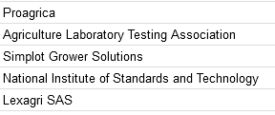
WG14 Potato Provenance: Farm & Field ID
Business Value:
Provide potato processors specific data on a batch of potatoes they receive.
Scope:
Farm and field polygons, coordinating with newly established Field Boundaries subcommittee. This group will primarily focus on data elements and formats used within the potato industry.
FMIS companies are mainly interested in Field Identification and field boundaries.
Status: On hold, dependencies on several other working groups, working though splitting scope up into additional working groups
Chair: TBD
Staff Liaison: Conny Graumans
Member Companies:
Notes:
A potato processor wishes to know on which field(s) a batch of potatoes was grown and harvested. The manufacturer would like a record of the field operations the grower has executed during the growing season, and an accurate yield count at harvest. In addition, the grower would like to know where the potatoes were stored and under what conditions. Comparing these data with the quantity and quality of the batch of potatoes allows the manufacturer to make recommendations to the farmer to improve yield and quality.

Slide 28
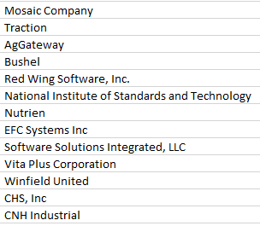
WG15 Scale Ticket
Business Value:
Provide electronic proof of receipt from entity to entity, starting at the point of origin in a standardized way (leveraging current standards), to a retailer or cooperative/ retailer/ processor who has received the commodity at the destination at the time of receipt.
We will define the Minimum Viable Product (MVP) that will help facilitate the financial settlements between the parties and provide sufficient identification that enables traceability.
Deliverables:
Sequence diagrams showing interactions among parties
OpenAPI spec addressing the MVP
Status: Reviewing use cases and existing documents, API’s, etc
Chair: Phil Kubish (VitaPlus)
Vice Chair:
Staff Liaison: Ben Craker
Current Member Companies:
Notes:
A potato processor wishes to know on which field(s) a batch of potatoes was grown and harvested. The manufacturer would like a record of the field operations the grower has executed during the growing season, and an accurate yield count at harvest. In addition, the grower would like to know where the potatoes were stored and under what conditions. Comparing these data with the quantity and quality of the batch of potatoes allows the manufacturer to make recommendations to the farmer to improve yield and quality.

Slide 29
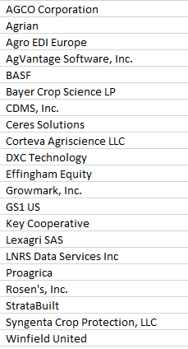
WG16 Crop Protection Product Guidelines
Chair: TBD
Staff Liaison: Brent Kemp
Current Member Companies:
Business Value:
The working group proposes to develop a set of industry agreed-upon documents that allow data owners to consistently load reference data to AGIIS, as well as providing data owners and consumers best practices in managing and implementing the reference data so loaded.
Scope:
Industry agreed-upon field-level mapping and examples of crop protection product in AGIIS
Industry agreed-upon best practices for product maintenance in AGIIS for both data owners and consumers
Impact assessment for implementing GTINs in eBusiness Messages already in industry use
Status: Reviewing best practices to inform guidelines

Slide 30
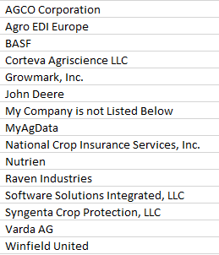
WG17 Field Boundaries: Use cases, terms & definitions
Business Value:
An unambiguous, core definition of a field and field boundary that can serve as the basis for different business use cases, can reduce effort and confusion across the value chain. Preserving the meaning of that core definition, while adding relative meaning for different use cases enabling farmers to share their field data more easily as well as assist in traceability efforts
Scope:
The Working Group will lead the effort in defining the overall use cases, terms and definitions surrounding field boundaries. The group will start with existing content from SPADE artifacts, work already done by WG14 Potato Provenance, work in the PAIL project as well as leverage existing standards and methods where possible. Such as ISO 19115 Geographic information — Metadata and ISO 19157 Geographic information — Data quality.
Status: Capturing use cases and identifying terms
Chair: TBD
Staff Liaison: Ben Craker
Current Member Companies:

Slide 31
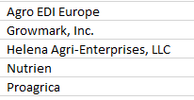
WG18 Crop Nutrition 3rd Party Warehouse Management
Business Value:
Crop nutrient product manufacturers and distributors have agreements for storage and handling of fertilizer to more readily and efficiently service customers. In order to effectively manage the inventory and resupply, stakeholders desire to implement electronic processes for ordering, shipping, and inventory management that align to existing ebXML processes for the segment.
Scope:
Develop implementation guidelines based on the existing OrderCreate, OrderResponse, ShipNotice, Invoice, and ReceiptNotice messages. ReceiptNotice will require a new profile, while the other messages will likely only need tweaks in implementation rules.
Messages and process documentation for Receipt into a Warehouse Partner location
Messages and process documentation for Purchase out of Warehouse Partner location
Messages and process documentation for Third-Party Sales Order out of Warehouse Partner location
Messages and process documentation for Warehouse-to-Warehouse Stock Transfer as requested by the product owner
Status: Reviewing existing messages for gaps
Chair: TBD
Staff Liaison: Brent Kemp
Current Member Companies:
TBD

Slide 32
WG19 ADAPT Serialization
Business Value:
This next working group in the Data Linking area will focus on modeling the Critical Tacking Events (CTE) and Traceable Resource Units (TRU) as component in Score, leveraging prior work like CART (Commodity Automation for Rail and Truck) and research by Kansas State and Texas State University. This will define the traceability components needed for an OpenAPI interface between partners to support container-to-container transfer events of commodity during farm/field operations (planting, harvest, load of semi-trailers) and transport events into the supply chain (deliveries, scale tickets).
Scope:
TBD
Status: Defining scope and deliverables to finalize charter
Co-Chair: Chris Ruttencutter (Corteva)
Co-Chair: Stuart Rhea (Syngenta)
Staff Liaison: Ben Craker
Current Member Companies:
TBD

Slide 33
WG20 Traceability API Working Group
Business Value:
With the widespread adoption of the ADAPT Framework and the ongoing ADAPT Standard work many stakeholders have expressed a need for a common method for serializing data. Once the standardized schema for the data model is complete a need will still exist to better facilitate the exchange of data between parties. This working group will document use cases, document requirements, and develop principles to develop a common approach to serializing data conformant to the ADAPT Standard. The work will be guided by three principles:
The format and semantics need to be open, everything serialized within ADAPT should be readable by anyone with permission to do so without specialized (proprietary) tools or resources
The data included in serialization needs to be flexible; the implementation will not mandate (but may recommend) what must be serialized, e.g. spatial data can be a point or a polygon
There will be a need to balance file size and human readability, but the information should be as human readable as possible
Scope:
TBD
Status: Defining scope and deliverables to finalize charter
CO-Chair: Scott Nieman
Co-Chair: Joe Tevis
Staff Liaison: Ben Craker
Current Member Companies:
TBD

Slide 34
WG Plans for 2023
Working group topics for the coming year

Slide 35
WG Timeline for H1 2023
NOV 2022
Complete
WG18 3rd Party CN
FEB
MAR
Complete
Complete
Start
WG20 Traceability Modeling
JAN 2023
Complete
Complete
Complete
Complete
Start
WG16 CP Guidelines
DEC
WG15 Scale Ticket
WG19 ADAPT Serialization
WG04, WG11 Modus
WG10 Ag Energy Ship Notice
WG13 Closed Loop Spray
WG14 Potato Provenance
APR
WG17 Field Boundary
MAY
WG19 ADAPT Serialization
JUN
WG20 Traceability Modeling

Slide 36
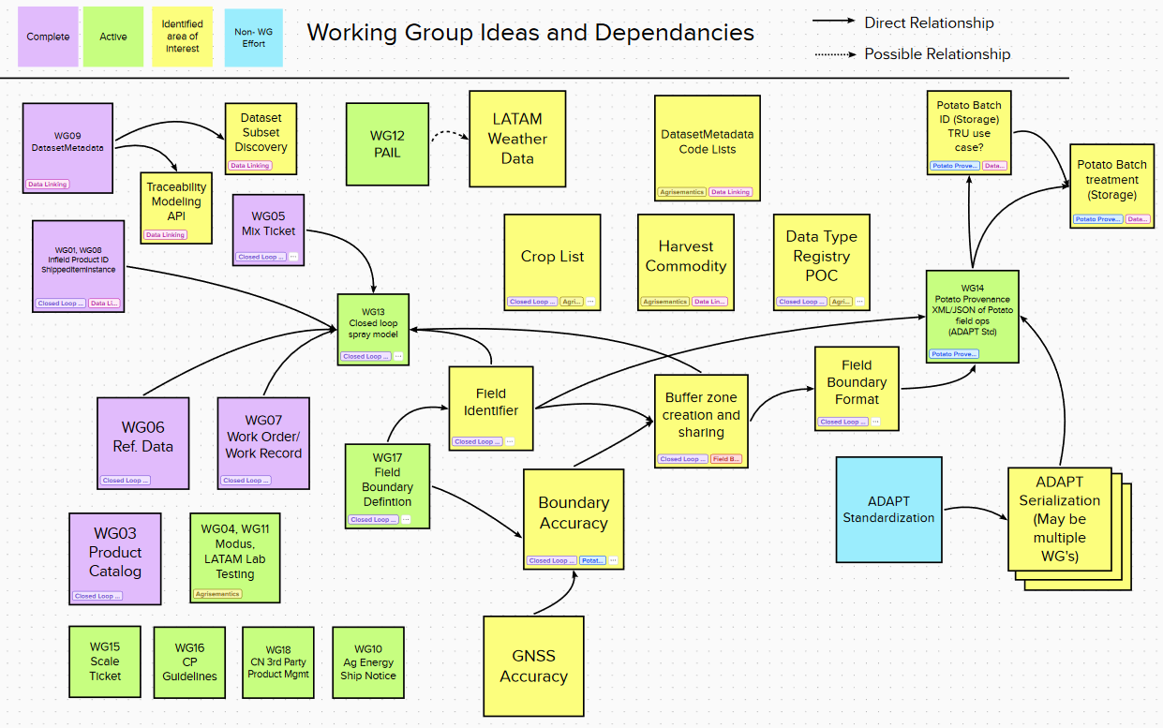

Slide 37
Potential Future Working Groups
Agrisemantics
  Data Type Registry PoC
  DatasetMetadata code lists
    Potentially multiple WG’s
  Harvested Commodity
  Crop list
Data Linking
  Traceability Modeling API
  Dataset Subset Discovery
  Potato Batch ID
Field Boundary
  Boundary Accuracy
    GNSS Accuracy
  Field Identifier
  Buffer zone creation & Sharing
  Field Boundary Format
ADAPT
  Serialization based on ADAPT Standard schema
  Sectional Polygon Data Transfer

Slide 38

Issues & Opportunities: What’s On Your Radar?
Submit an Idea for a Working Group
Request a meeting

