Slide 1
WG12 PAIL: Irrigation Standard Working Group
Annual Conference 2022

Slide 2
Agenda
Intro to PAIL
Update on standardization process
Workshop on obstacles to implementation
  Target audience, knowledge gaps, stakeholder ROI
  Sample Use Cases
Notes:
Status update, plans for ISO Standard
Focus on implementing PAIL
Work shop identifying obstacles to implementation
Who is target for implementation
What do they need to understand/get started
What are the benefits to different stakeholders for implementation
Identify use cases and how they fit, walk through to identify implementation guidelines, ROI, etc
Have one or two identified to maybe kick things off
Utilize figures to talk through what happens, where PAIL provides value
Possibly re-use material form IA show workshop a couple years ago (Below)
Also can use diagrams from ISO discussion for a drip example

Slide 3
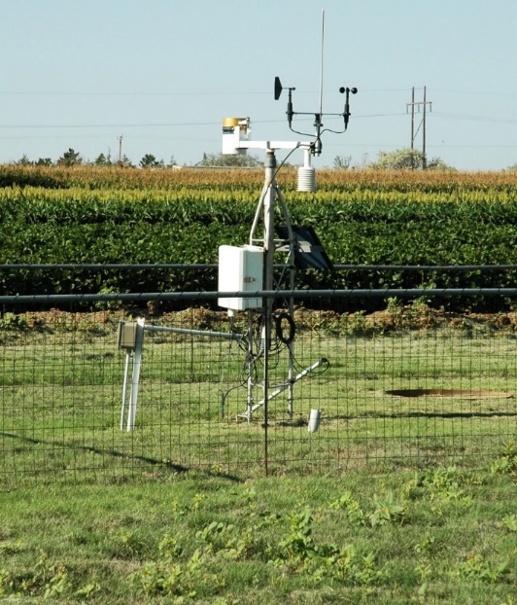
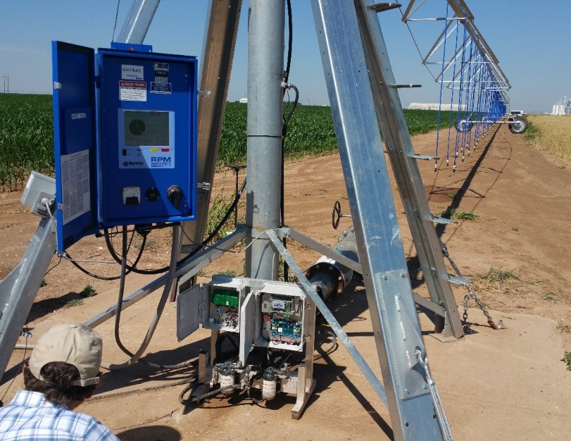
PAIL Scope
Observations
Operations
Notes:
Observations are the field, atmospheric, plant, or other in situ measurements that apply to irrigation management. This includes weather stations, soil moisture sensors, or crop-related sensing. This work is based on, and extends, the ISO19156 standard for observations and measurements (International Organization for Standardization, 2011).
Operations are all of the activities associated with the application of water with an irrigation system. This includes, but is not restricted to, management-level communications and record keeping. The operations data set is based around a Recommendation, which describes a suggested course of action; a Work Order, which describes a desired course of action; and a Work Record, which describes what actually occurred. This work is based on, and extends, the ISO11783-10 standard for communications between agricultural machinery and FMIS (International Organization for Standardization, 2015).

Slide 4
PAIL v1 Scope
Observations and Measurements: The collection of data from crop scouting, moisture sensors, weather stations, and other data sources ("What is happening in the field."). Observations can be informed by a crop plan.
Operations: The creation and execution of a field task (e.g., planting, irrigation, crop protection, crop nutrition, harvest) associated with growing a crop. It includes recommendations, work orders, and work records.

Slide 5

Process
PAIL Team
S&G
ASABE X632
ISO TC23 SC19
ANSI
PAIL
Working
documents
ISO TC23 SC19 NWIP
X632
draft
National
standard
International
standard

Slide 6
PAIL Submitted as One Standard, with Multiple Parts
Part 1: Core Concepts : business processes, identification, controlled vocabularies, time, space, etc.
ASABE APPROVED!
Part 2: Observations and Measurements
DRAFT
Part 3: Operations
ASABE APPROVED!
Notes:
!

Slide 7
Drip Use Case

Slide 8
Drip Use Case
Blocks vs Sets
Declining GPM during season

Slide 9
Drip, sequential sets

Slide 10
Drip, two Sets

Slide 11
Declining GPM

Slide 12
Severe water shortage

Slide 13
WG12 PAIL
Annual Conference 2022
Implementation Workshop

Slide 14
Target Implementers/Promoters
Irrigation equipment manufacturers
FMIS providers
Government agencies (USDA, NRCS, etc.)
Irrigation Association
Other?

Slide 15
Value Prop: Farmers
Growers are inundated with many types of data. Common themes the PAIL Team has heard:
  Growers spend too much time trying to sort through data that comes to them through different portals or websites
  Each piece of farm equipment not only sends its own data, but does so in a different format, through its own data portal
  User interfaces vary, and many are difficult to understand
  The issues above hamper the conversion of data to meaningful, actionable information
  Using a mixed fleet (different brands) of equipment compounds the issues above
For growers who want to improve their irrigation practices:
  Irrigation systems that use the PAIL data standards will provide them more accurate and precise data because their irrigation equipment will be able to exchange data with Farm Management Information Systems.
  Growers will no longer have to consult with a third party just to integrate all of the data from different in-field irrigation equipment.
  Systems that use the PAIL data standards making efficient practices more understandable, and simplify the way data is “moved around the web.

Slide 16
General Value Prop: Companies
Financial Benefits:
  Reduce the time and effort required to interact with multiple vendors
  Remove the barrier to growers of having to learn multiple data systems.
Technological Benefits:
  Vendors can enable their equipment or software to interact with an irrigation application without specific code for each
New Market Opportunities:
  Working in partnership or in short-term alliances, vendors can create new market opportunities with data-driven products and services.

Slide 17








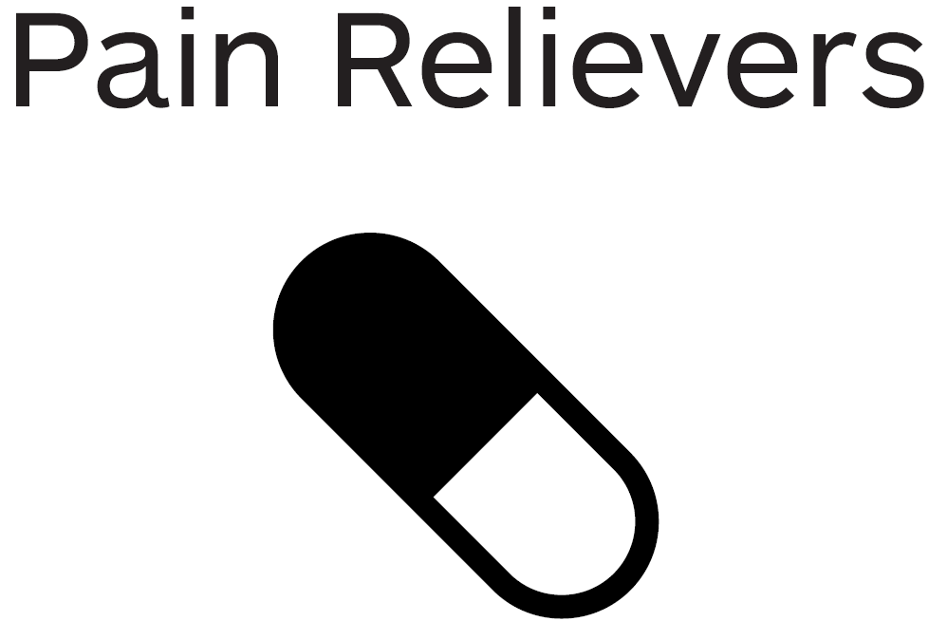
FMIS Company?
PAIL has something for YOU!
We do not have to reference every single point of data every time.
Growers value how we protect their data and recommend us.
PAIL
We know who authorized the work orders and work records.
Keep it simple and not have to include every nuanced geo-political difference.
Use data only as authorized by the grower.
Compound-
Identifiers and UniqueIds.
Work Order and Work Record Documents.
If another FMIS uses a different way to identify data objects, we can still use the same documents.
Every little change due to some local requirement to the same object – Aghh!!
Share a document with other FMIS companies.
For most items, we can use standard data formats
Multiple teams are involved and they each use different terminology.
To find out more about how your company can take advantage of PAIL, contact the PAIL Team at pail.feedback@aggateway.org

Slide 18
Value to FMIS Providers
Implement once integrate many times
Not having the have a different format for prescriptions for every manufacturer
Possibility of receiving data with good semantics to drive scale

Slide 19
What’s Needed to get Started:
FMIS Companies

Slide 20
Irrigation Equipment or Services Company?
PAIL has something for YOU!
By connecting our data with other providers we can add new value to customers.
Grow our business with new, integrated solutions.
PAIL
Invest in future opportunities.
Save R&D and Support time and dollars.
Provide irrigation scheduling recommendations and work orders.
Standard data formats for observations in agriculture.
Standard data formats for irrigation operations.
Customers do not need to learn multiple data systems.
Our growers are complaining that our equipment doesn’t play well with others.
Collect and send relevant observations and measurements.
No need to re-write application-specific code when that app changes.
Different companies and orgs have many ways to describe weather data.
To find out more about how your company can take advantage of PAIL, contact the PAIL Team at pail.feedback@aggateway.org

Slide 21
Value to Equipment Manufacturers

Slide 22
What’s Needed to get Started: Equipment Companies

Slide 23

Crop Protection Company?
PAIL has something for YOU!
0
Specify the meaning of what is being measured, and how it is measured.
Easier and more consistent reporting.
PAIL
Unambiguous results across different teams.
Fewer unnecessary regulations.
Conducting field trials under different conditions & w different teams.
Nascent code component.
Product Reference Data; Work Order Core Document.
Grower can specify who has authorization to apply product.
Customers do not always have latest info on product use.
Help ensure proper use of crop protection products.
Customers can be directed to manufacturer’s url for up-to-date info.
Unauthorized application of products.
To find out more about how your company can take advantage of PAIL, contact the PAIL Team at pail.feedback@aggateway.org

Slide 24

Seed Company?
PAIL has something for YOU!
0
It’s SIMPLE and you can link to more complex resources (e.g. trait ontology).
Specifying field boundaries is easy and consistent.
PAIL
Farm and field boundaries can be described once and then referenced.
We all mean the same thing when describing soil and seed properties.
Conduct seed variety Trials.
Reference,
Set Up and Configuration Data
Framework for observation codes
Alignment on how properties are observed and measured.
CSV files and XML files are killing you!
Ensure customers use seeds correctly (Stewardship).
Standard data formats
Multiple teams are involved and they each use different terminology.
To find out more about how your company can take advantage of PAIL, contact the PAIL Team at pail.feedback@aggateway.org

Slide 25
Value to Government

Slide 26
Value to Irrigation Association

Slide 27
Backup slides

Slide 28







Field Operations Processes, Core Document Flow
Observations & Measurement
Crop Scout or Other Data Source
Plan
Reports
Observations & Measurements
Partners & Sustainability
Grower
Work Record
History
(Work Records, Observations & Measurements)
Advisor
Work Order
Service Provider
Recommendation

Slide 29

Core Documents and their Relationships
Observations
Operations
Motivates
Plan
Informs
Provides
context for
Informs
Observations
and Measurements
Recommendation
Informs
Provides
context for
Provides
context for
Reference, Setup
and Configuration
Data
Motivates
Informs
Provides
context for
Provides
context for
Work Record
Is
represented
by
Work Order
Motivates
Field operation

Slide 30
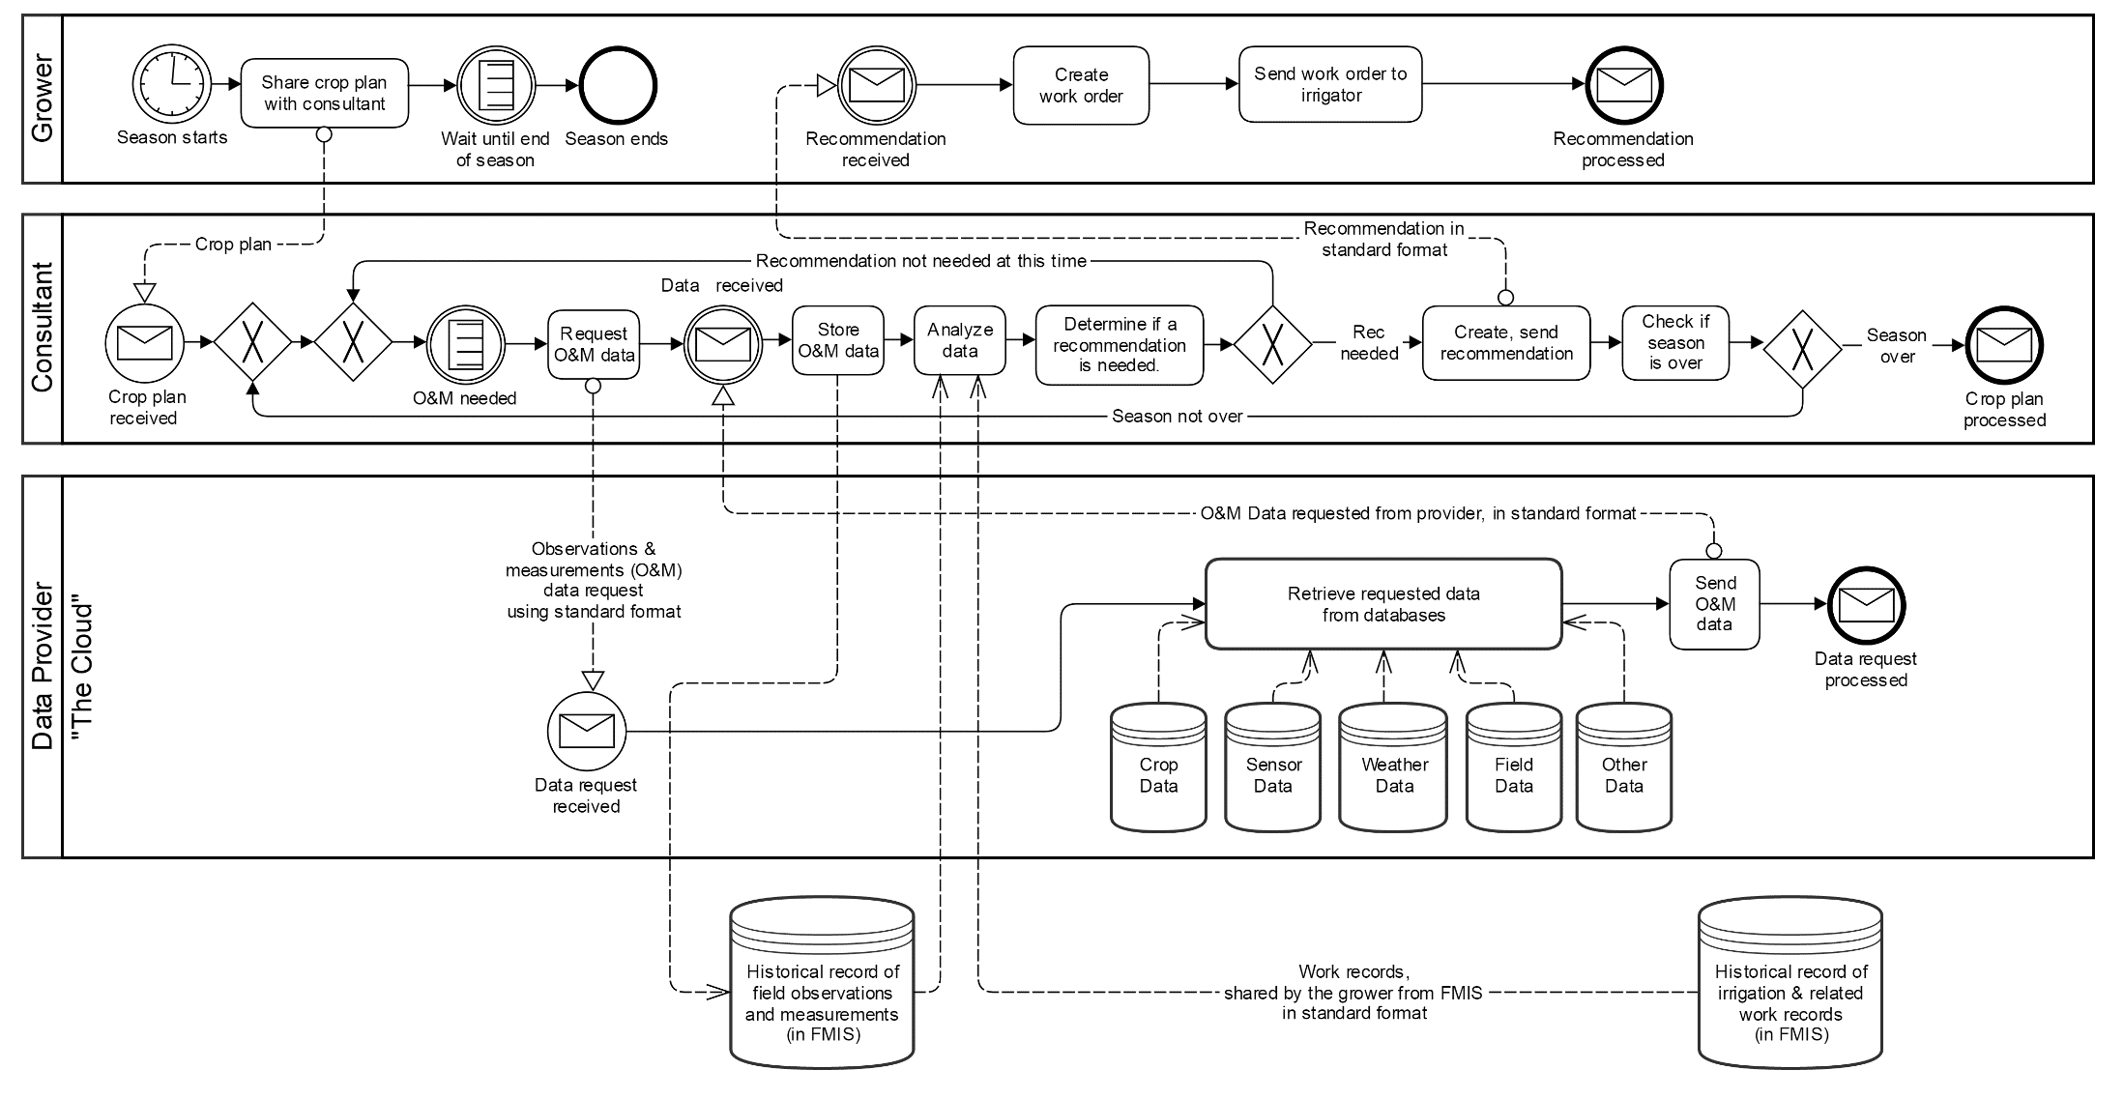
What an OM Process looks like

