Slide 1
Data Linking Subcommittee
Annual Conference 2022

Slide 2
Agenda
Agenda check
Harvest tracking proof of concept
2022 WGs Recap
In-field Product ID
DatasetMetadata
Traceability API
Driving Implementation
WG Roadmap for 2023

Slide 3
2022 Grain Traceability Pilot
Development of Implementation Guidelines

Slide 4
Pilot Objectives
Develop the concepts and definitions of core traceability components:
CTE, Critical Tracking Events,
TRU, Traceable Resource Units
Develop implementations of the concepts applied to the Use Case of traceability of bulk commodity grains specifically corn and soybeans
Develop and test concepts for TRU management for this use case
Develop use cases to test metadata and Open API standards being developed to facilitate the discovery of relevant data contained in third party data repositories:
Combine yield monitor data
Grain cart load cell data
Develop specifications for Open API standards for the retrieval of specific data elements from these repositories

Slide 5
Harvesting System Used in Pilot

Slide 6
Pilot System Requirements
Mobile Device
Create CTEs for all transfer events,
Create and manage active TRUs for all containers/vehicles
Record relevant key data elements and attach to appropriate TRU
System Server
Maintain a repository of all containers used in the harvest
Maintain a real time “state” of each container,
Maintain an log of key events for each container in the system
Implement API(s) for interaction with:
Other “linked” systems
Containers
Linking TRUs
Data repositories containing key data elements

Slide 7
TRU Management Rules
Each container will be associated to multiple TRUs during a harvest season
At any time a container will be associated with only one TRU (active TRU)
Each container is responsible for its TRU management
Defining new TRUs
Publishing its current active TRU to the rest of the harvesting system

Slide 8
Implementation Hardware
Mobile Devices
Android Tablet – Samsung Active3 (1)
Android Phone – Samsung S10 (2)
Specs:
GPS
SQL Lite db
Server
AWS Serverless
Postgress db
AWS Gateway API
Lambda functions (Python v3.7)

Slide 9
Pilot Results

Slide 10
Pilot Results (con’t)
485 total Transfer CTE’s
Field->Combine – 191
Combine->Grain Cart – 179
Grain Cart -> Semi - 66
Semi -> Storage Unit - 41

Slide 11
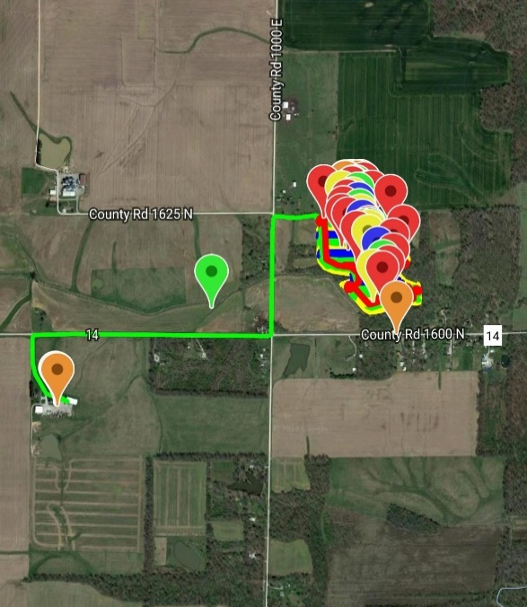
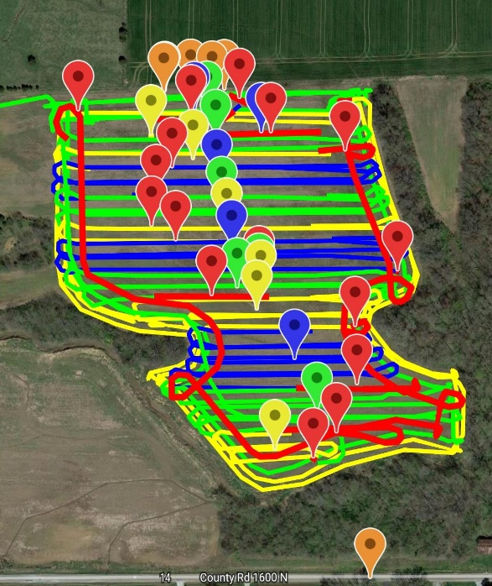
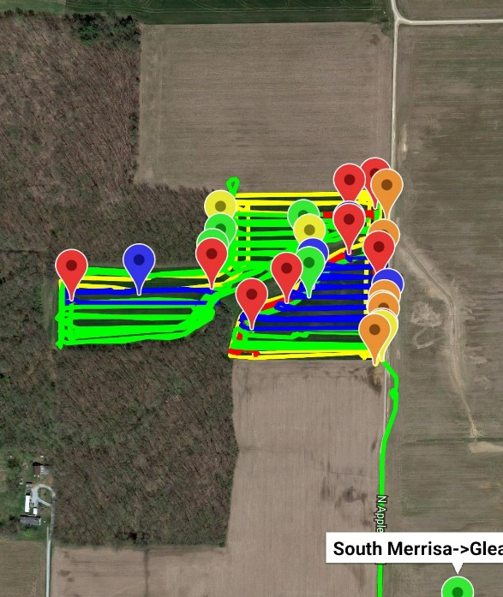
Visualization Challenge

Slide 12
Lessons Learned

Slide 13
Transfer CTE Fundamentals
Time Scope
Start
Stop
Containers
Source
Target
Active TRUs
Source
Target
Material
Type
Quantity

Slide 14
Container Proximity Detection
Technologies
IoT – Bluetooth
WIFI SSID
Geo-location
BarCode
Lessons Learned/Guidelines
For fixed assets geo-location is the clear winner
WIFI SSID has the advantage of broad implementation
IoT Bluetooth requires programmable device for each container
None are 100% effective

Slide 15
Data Linking API
Data Linking
Leverage Dataset metadata; need OEM and FMIS to use it
Open API Standards
Base URL and End Points
Device ID provided by OEM
Access/permission token
Requested data identifier (ex. ISO11783 DDI)
Time Scope

Slide 16
TRU Linking
Seafood Traceability SYSTEMS: GAP Analysis OF Inconsistencies IN Standards AND NORMS
https://pdf4pro.com/view/seafood-traceability-systems-gap-analysis-of-357b04.html
Internal
Internal traceability is the traceability within a link or a company
Chain
Chain traceability is the traceability between links and companies, and it depends on the data recorded in the internal traceability system being transmitted, and then read and understood in the next link in the chain
Trading partners must agree on how to identify the TUs and then send the required information through another channel (fax, mail, through electronically integrated systems) while referring to the TU in question.

Slide 17
TRU Linking
Purpose
Transfer CTE define transfers between source and target containers AND their respective “active TRUs”
Types
Linking “within system” CTEs
Linking “across systems” CTEs
API Parameters
Access/Permissions token
ContainerID
Time Scope

Slide 18
Implementation Technical Issues
Referential Integrity
Containers
Active TRUs
Redundant points in “crumb trail” WKT linestrings
For Oct. 19 data
291,000 ->9300 with a simple generalization algorithm
Time Synchronization

Slide 19
Opportunities for Innovation
Automated “Data Linking” and retrieval
Dataset Metadata standards,
OpenAPI standards for linking and retrieval
Mobile Device - CAN Interface
Use CAN messages to replace “button push”
OEM Integration
Replace mobile device
Requirements:
Shared Container Repository
TRU Management Algorithms
Simple proximity detection over-ride UI
Material Flow Modeling
Harvest - “On-The-Go” unloading
Planting -

Slide 20
WG20 Traceability API Project Overview
Recap

Slide 21
API track
Leverage prior work
CART
KSU / TSU ontology research
Dataset Metadata
Years of discussion
Model TRU, CTE and related components in Score
Use components to build OpenAPI definition
Enable service providers share datasets using Dataset Metadata integration from which CTEs and TRUs can be elicited using processing algorithms

Slide 22
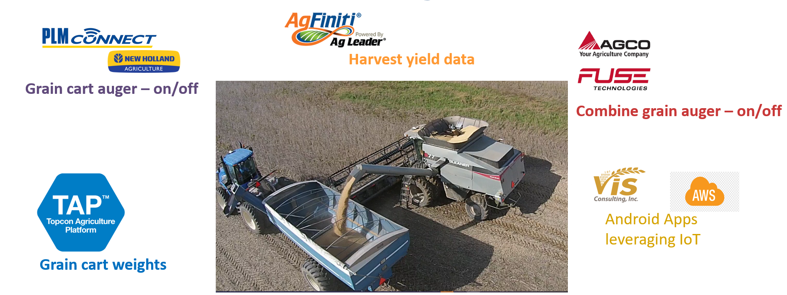
Dataset metadata driven integration
Traceability API ideas for client:
GET /tru-list?kde.id=$&kde.type
GET /cte-list?kde.id=$&kde.type
API Client
Traceability Repo
(discovered
CTEs, TRUs)
Notes:
The OEM Platform alone is not enough to solve the transfer event discovery, that all datasets and event messages needed to be merged together to truly identify the transfer event. With integration via the recently released Dataset Metadata, data can be more easily shared to traceability repositories where TRU and CTE discovery can take place, and an API can be provided for future root cause analysis.

Slide 23
Dataset Metadata
Agricultural Use Cases for Data Linking

Slide 24
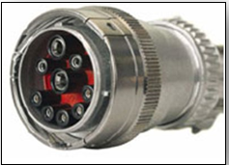
Background

Slide 25
Precision Agricultural
ISO 11783 extends ISO 11898 Controller Area Network standard
Large datasets generated while performing field operations
Farmers own mixed fleets
Tractor displays don’t last forever; retrofits available
Different Cloud platforms

Slide 26
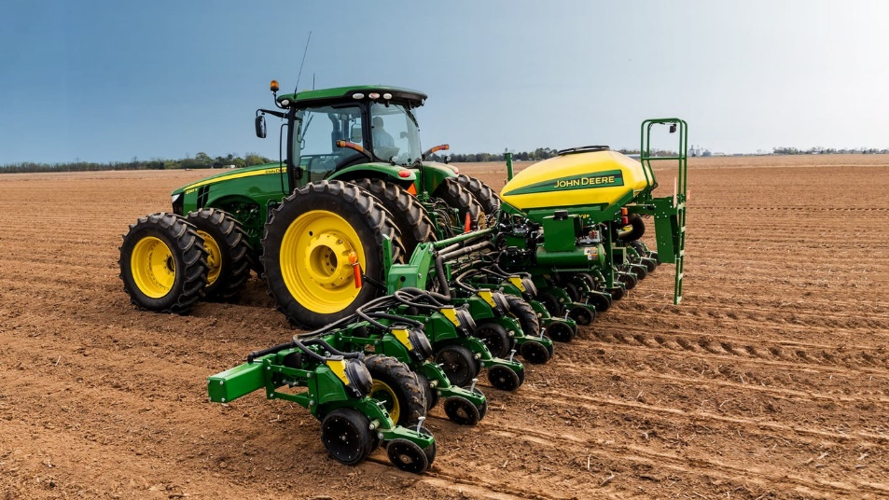
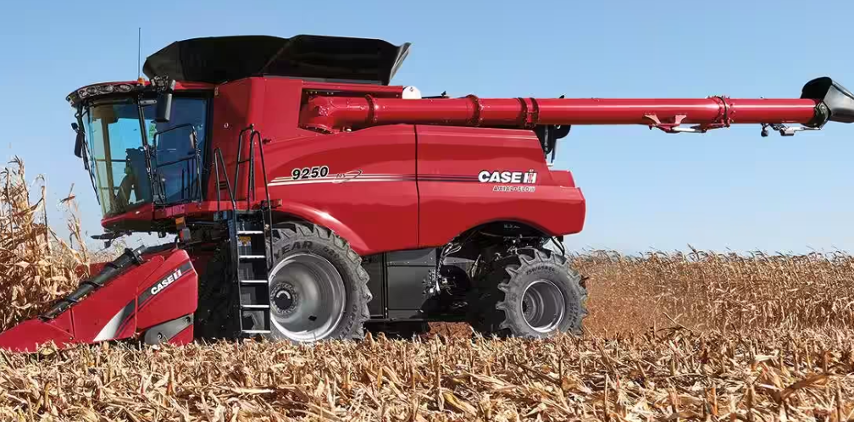
Mixed Fleets

Slide 27
Supply Chain pressures
Supply chain pressures to trace premium commodities
More direct ship to processor from field
Field to fork traceability
Accurate inventory management of commodities
Food origin, quality, and safety concerns increasing
Consumer Demand (gluten-free, non-GMO)
Product Recall (listeria, e-coli, etc.)

Slide 28
Agricultural Lifecycle
Soil Health
As-Applied
As-Harvested
As-Planted
Weather
Supply Chain
Exploded view
Equipment
Manufacturers
Technology
Providers
Agronomy
Services
Testing
Services
Crop Nutrient Manufacturers
Food
Processors
Consumer
Retail
Crop Protection Manufacturers
Co-op Retail / Elevators
Seed Manufacturers
Animal Nutrition Services

Slide 29
State of Precision Ag
Some improvements of equipment capabilities
OEM and FMIS Platforms moving to proprietary OpenAPIs
AgGateway ADAPT frameworks has provided better data translation capabilities, interoperability
Still limited capabilities to capture product information in the tractor display and related data (lot, shipment id)
Hard for farmers to share data across platforms

Slide 30
Product driven approach

Slide 31
Closed Loop Approach
Manufacturer
Distributor
Retailer
Field Operator
Farmer
Product Catalog
Agronomic
R&D Product Spec
Packaging
Warehouse Locations
Manufacturing Batch/ Lot
E-Commerce
Shipments with Lot/Batch
Agronomic Recommendations
Sales
Shipments with Lot/Batch
Planning
Receipts with Lot/ Batch
Finance
Assets
Asset Utilization
Work Order
Product Identification with Lot /Batch
Work Record Datasets (CN, Seed, CP, Harvesting)

Slide 32
Product Centric View
OEM Platform
Raw Datasets
POST
/shippediteminstance
GET
/setupfiles
Manufacturer
Retailer Systems
Product Setup
Catalog API
Co-operative/ Distributor
ShippedIemInstance API
Tractor Display
Orders
Shipments
GET
/catalog
GET
/catalog
POST /plantingworkorder
GET
/shippediteminstance
Reference Data API
FMIS
Improving the quality of our raw work record datasets starts with accurate product information

Slide 33
Data linking

Slide 34
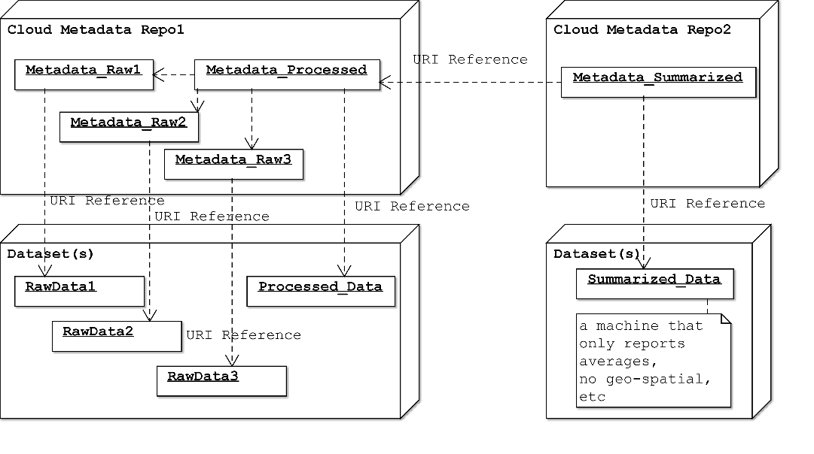
Different types of Linked Data
Datasets –‘big data’ from logged field operations work records
CAN messages
Weather conditions
Soil health test results
Business Transactions leading up to these operations
Data itself is NOT sufficient to link – need metadata about the data

Slide 35
‘Simple’ Harvesting Use Case
Harvest yield data
Grain cart auger – on/off
Combine grain auger – on/off
IoT proximity sensors
Grain cart weights

Slide 36
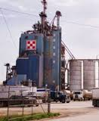
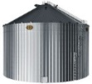
The ‘Perfect’ Storm
Seed Manufacturing
Crop Protection
Manufacturing
Crop Nutrition
Mix (MixTicket)
Co-op Grain Elevator
Semi Trailer
Semi Trailer
Distribution
Retailer Sales
Retailer/Elevator Receipt
Processor
Receipt
Semi Trailer
Weather
Soil
Grower Receipt
On-Farm Storage
Crop Nutrition
Application
Planting
Crop Protection
Harvest
Notes:
What are the arrows depicting? Reference links?

Slide 37
Dataset metadata

Slide 38
Our Approach: 3+ years of work
FAIR Principles
Dublin Core
W3C DCAT
Dataset Metadata

Slide 39
FAIR Principles
Findable – Key Data Elements, Text to help search and match
Accessible – Security, Who to contact, Retrievable
Inter-operable – understand the format of the data
Reusable – richly described to articulate its value
https://www.go-fair.org/fair-principles/

Slide 40
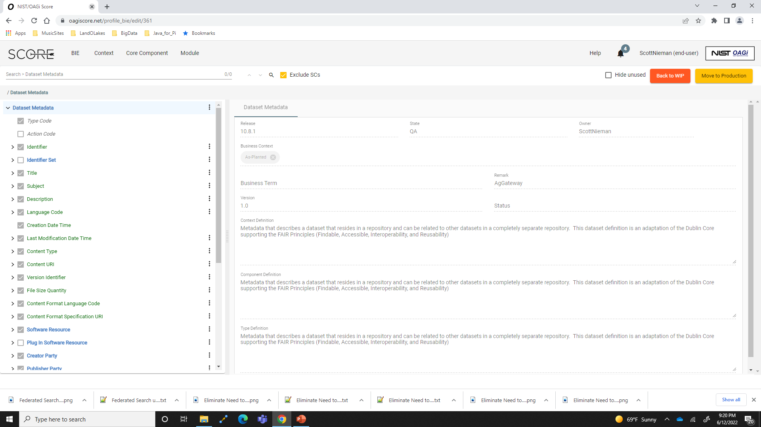

Slide 41
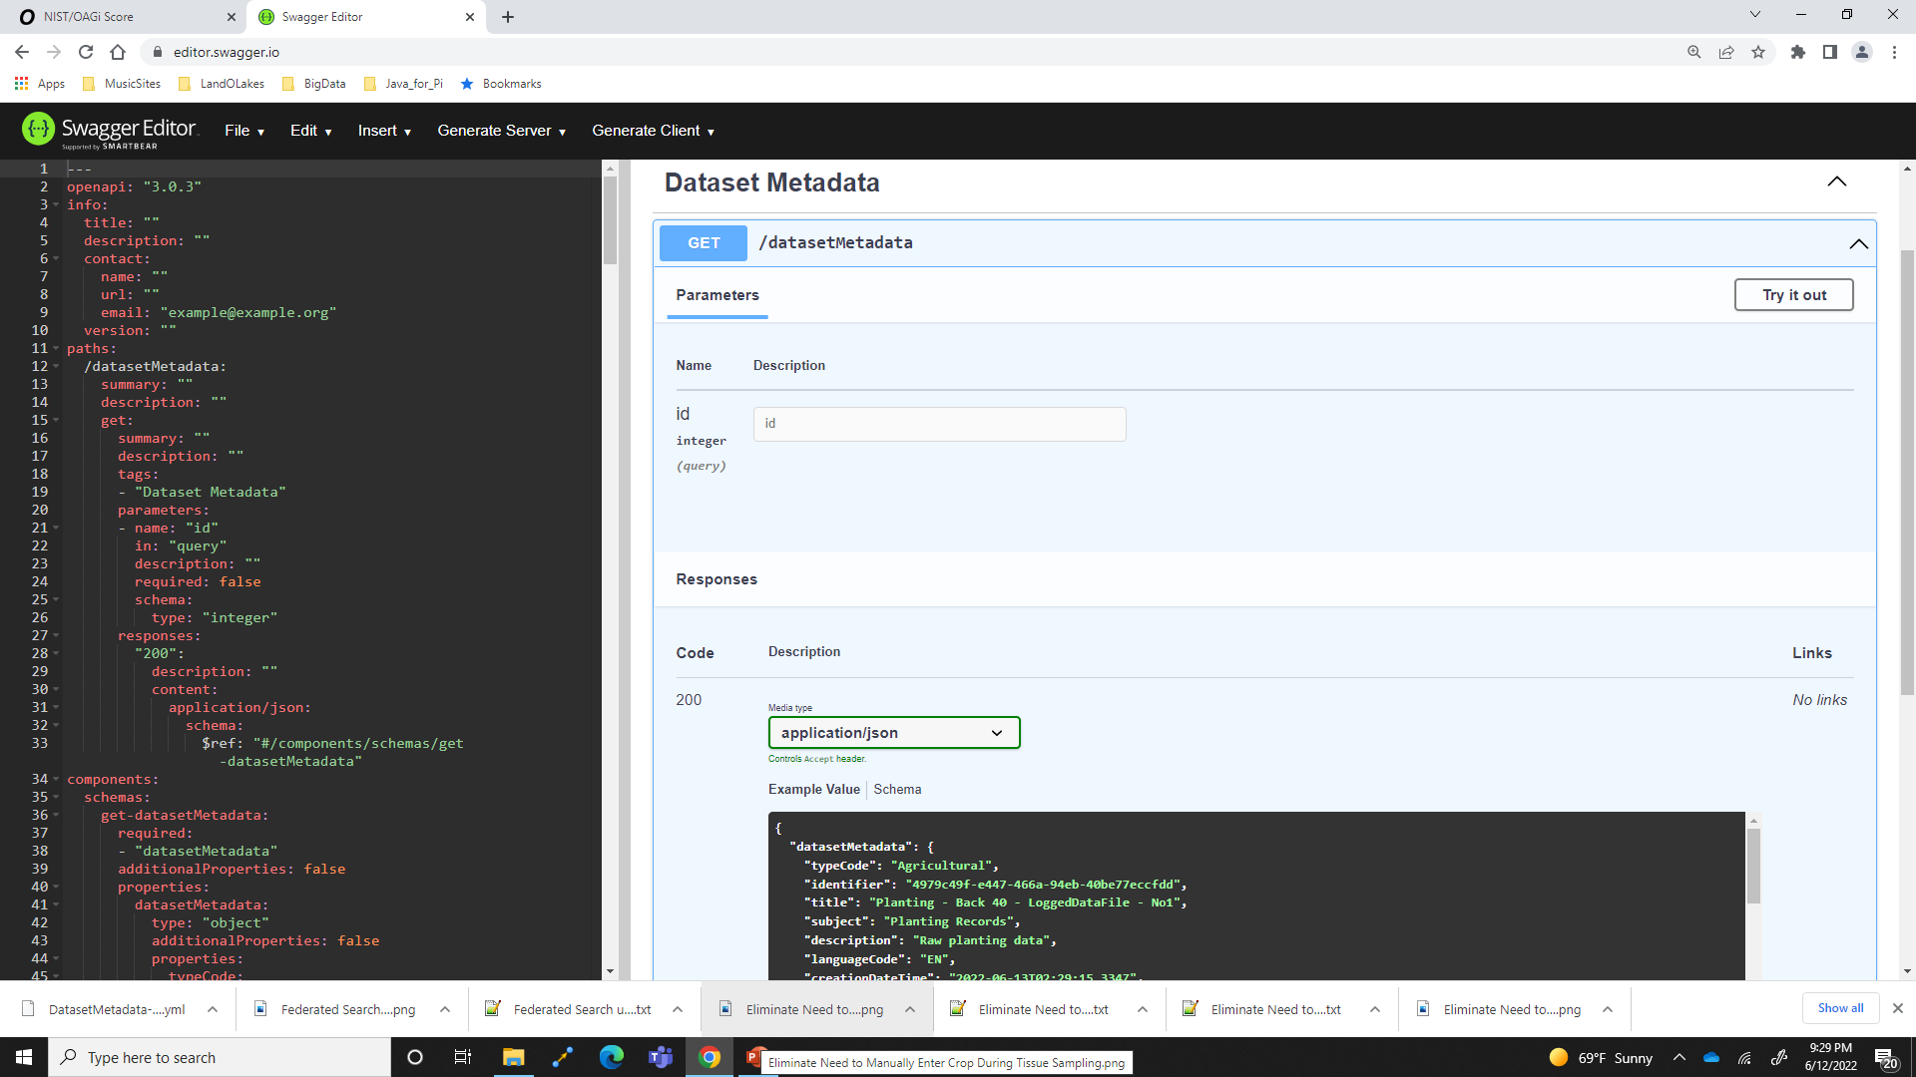

Slide 42
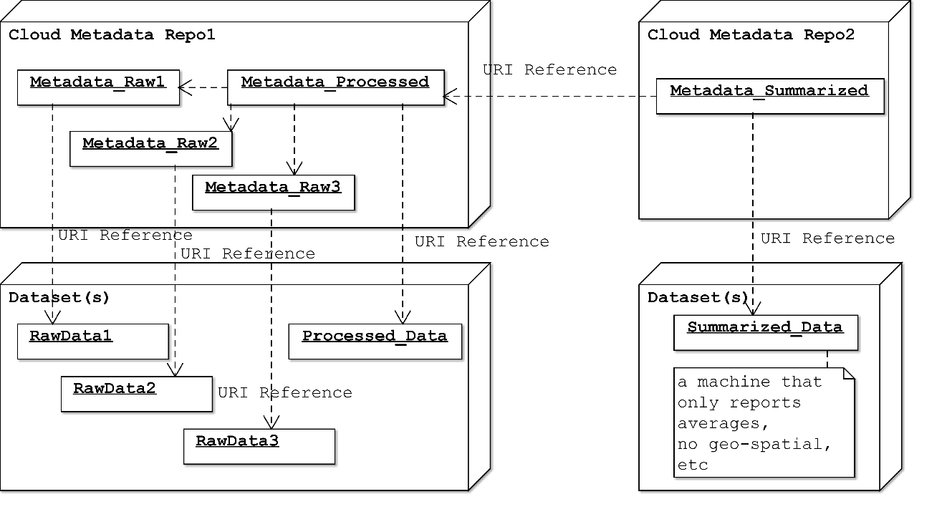
GitHub Review
Schema
Example for processed data

Slide 43
Use cases

Slide 44
Improvements to Business Processes
Since we know planting records…
No need to identify product during tissue sampling
No need to identify product during harvest operations
Better inventory management including segregation of premium commodities

Slide 45
Sharing of Datasets Farmer needs a consistent experience
Raw
Processed
Summary

Slide 46
Findable
Product recall, locate origin of aflatoxin
Federated search across several Cloud Platforms
Peer-to-Peer

Slide 47
Driving Implementation
Next steps for completed Digital Resources

Slide 48
Agrisemantics
Process for identifying, submitting, updating controlled vocabularies

Slide 49
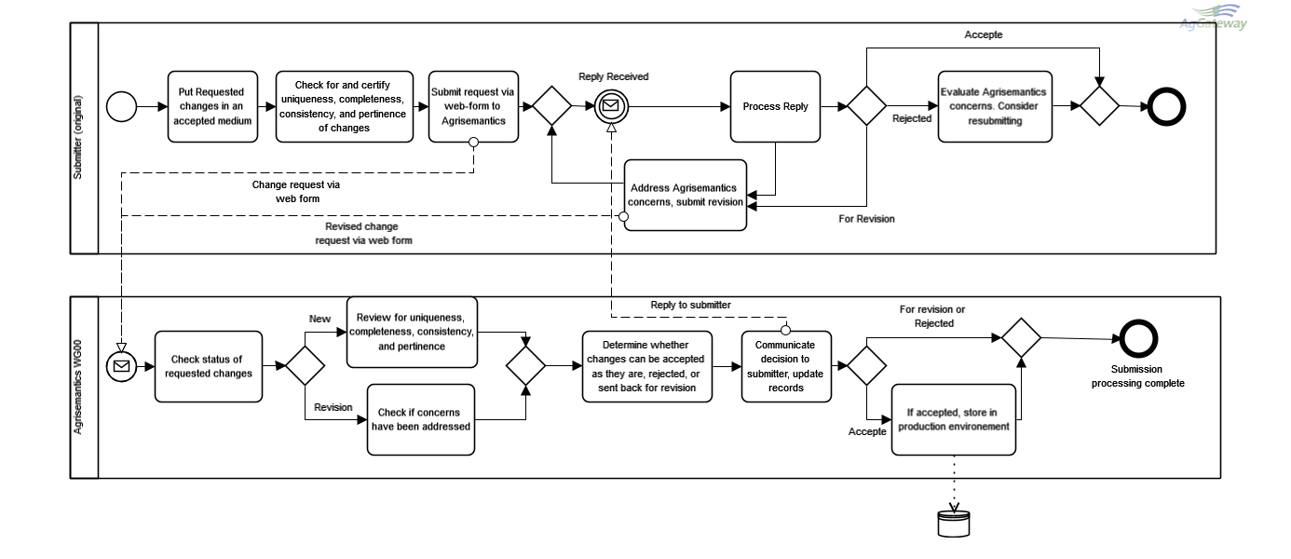
Agrisemantics Submission

Slide 50
Future Working Groups

Slide 51
