Slide 1
Directory Oversight Committee
November 16, 2022
Facilitated by Darlene Gibson

Slide 2
DOC Purpose
The Directory Oversight Committee – the DOC - is charged with establishing policies in the operation of AGIIS, the industry recognized repository of common entity and product information. We evaluate, prioritize, and execute enhancements in response to subscriber and AgGateway project requests. We oversee the maintenance and care of the data in the directory.

Slide 3
DOC Membership
Voting Membership
The Digital Resource Center will use the Subscriber Representation Matrix (Combination of Industry segment representation and organization's role in supply chain), to nominate candidates for voting seats on the DOC
3-year Terms
Current users familiar with AGIIS
Full AGIIS subscriber members of AgGateway
Subscribing companies – each company can only have one DOC rep
Non-Voting Membership
AgGateway staff representative(s)
Database hosting company representative
Advisory positions
Meetings
1 – 2 hour call each month
1 – 1 hour call each month as needed

Slide 4
Current DOC Membership

Slide 5
Meeting Agenda
Review DOC Wiki page
Enhancement Update
General Updates
New PCR and Entity Scenario Review
GS1 Update

Slide 6
AGIIS Enhancement Update
Enhancements Completed in 2022:
PCR 239 - AGIIS Product Package Id Business Rule Change
Password Management SOW
PCR 241 - Member Services Request Review Enhancement
PCR 242 – GLN Non-Re-use Rule Enhancement Review
PCR 243 - Two Factor Authentication Enhancement
PCR 244 – Entity Response Email Notification

Slide 7
AGIIS Enhancement Update
PCR 243 - Two Factor Authentication Enhancement
PCR signed 9 September
PCR released to production on 22 October
Release Notes published 24 October
PCR 245 – Product Directory Modification (Addition of Indicator Digit)
Will review PCR 245 (75 Development Units) later in the presentation.
Notes:
When a PCR is released to production not only Release Notes are emailed out, the enhancement is sent out via the AgGateway Social Media team, posted to AGIIS Directory News and added to the AGIIS Enhancements section of the AgGateway website.

Slide 8
AGIIS Enhancement Update
2022 DOC Development Units (DU’s) Review
Started 2022 with 500 DU’s
358 DU’s have been approved and implemented
75 DU’s pending approval
67 DU’s remaining

Slide 9
AGIIS Update

Slide 10
AGIIS Update
Disaster Recovery
The DXC Disaster Recovery team delivered the Final Report from the DR Exercise (29 August - 1 September) and it was signed off by AgGateway Staff on 20 October.
The 2023 DR Exercise has been set for 28 August – 1 September.
Password Management Enforcement
Member Services is working with Subscribers to ensure any password that does not meet the minimum requirements is inactivated.
Notes:
A LACS/NCOA process is run bi-annually for entities with an address consisting of a rural route and box number (RR# Box#) in order to apply 911 updates

Slide 11
AGIIS Update
AGIIS Annual Maintenance Activity Schedule
Annual Disaster Recovery Test was completed 29 August – 1 September
Annual Maintenance Activities – Weekend of 3, Dec 2022
LACS & NCOA Processing
Inactivating entities with no subscriber cross reference
City/State Review
Address Standardization Update
Annual De-duplication – Weekend of 17, Dec 2022
A communication will be sent out 21, Nov 2022 regarding all activities

Slide 12
PCR Enhancement Review

Slide 13
PCR 245 – Review
Overview
PCR 242 – AGIIS Product Directory Modification (Addition of Indicator Digit)
Cost – 75 Development Units
Schedule – 35 Business Days
Communication plan – Will send Release Notes (pre and post) to notify users of the modifications.
Reason for Enhancement
Is a recommendation of AgGateway Working Group 16, Crop Protection Product Guidelines.
The recommendation aligns with GS1 Standards and meets the need of AGIIS Subscriber Product Owners
Notes:
Schedule - Completion date will be contingent upon any other projects and activities in the pipeline.

Slide 14
PCR 245 – Review
Key Features
The Indicator Digit would replace the Package Level Indicator Code and would be the first digit in the GTIN 14.
The indicator digit would not have any association to a specific package configuration level. Product Owners would be able to use any digit “0” – “9”.
AGIIS will be modified to use Indicator Digit logic instead of a Package level Indicator Code which includes:
Web interface
Web services
Bulk process

Slide 15
PCR 245 – Review
Key Features
Changes will result in modifications to the following AGIIS documentation:
File Layout Formats
Page Level Help Documentation
Perform Quality Assurance testing
User Acceptance Testing (UAT) will be conducted by Member Services and Subscribers.

Slide 16
PCR 245 – Review
Considerations
AgGateway Working Group 16 will assist in providing the verbiage for Indicator Digit in the AGIIS Product File Layout Documentation.
Product Owners will be encouraged to implement the GTIN Hierarchy consistently for their product line and communicate the hierarchy with their trading partners.
GS1 defines the use of the Indicator Digit as the following “Used for GTIN-14, "1" to "8" indicates a packaging level and "9" a variable measure item. Zero in this position is not considered an Indicator Digit, but rather a pad or fill zero. There is, however, no worldwide consensus on which number indicates which packaging level and no significance should be built into this number.”
Next Steps
Discuss and vote on PCR

Slide 17
ENTITY Scenario Review

Slide 18
Entity Scenario Review
Situation: Address Line 1 content
Situation Description: Situation was brought to Member Services attention by a Subscriber User. Address Line 1 contains a name or non address related data and Address Line 2 contains the Address information. This specific entity caused transaction processing confusion (Farm name vs Grower name) between trading partners.
Question Asked – Is non-address information allowed in Address Line 1 (Physical and Mailing)
Response – The intent of AGIIS Business Rules is not to allow non-address information in address line 1 but if a valid address exist in Address Line 1 or Address Line 2 it is prohibited. The only exception specified in the business rules is Public Warehouse which allows C/O and the name of the physical warehouse in Address Line 1
Occurrences: When performing a query of entities that contains no numeric digits in Address 1 there were 103,732 entities.

Slide 19
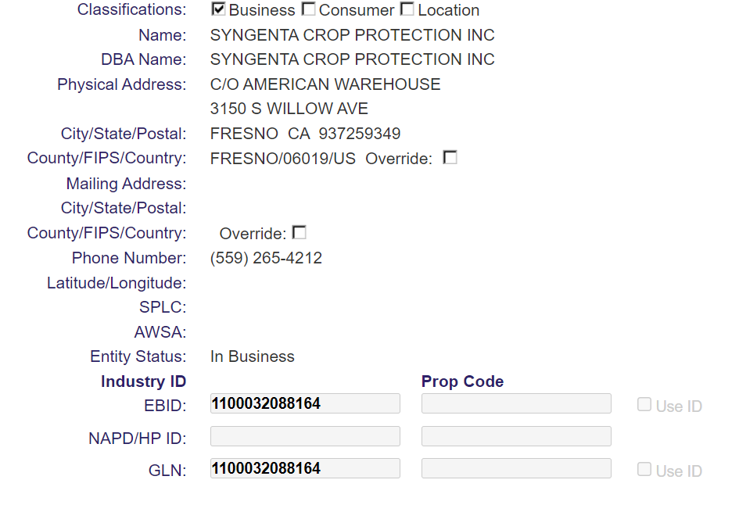
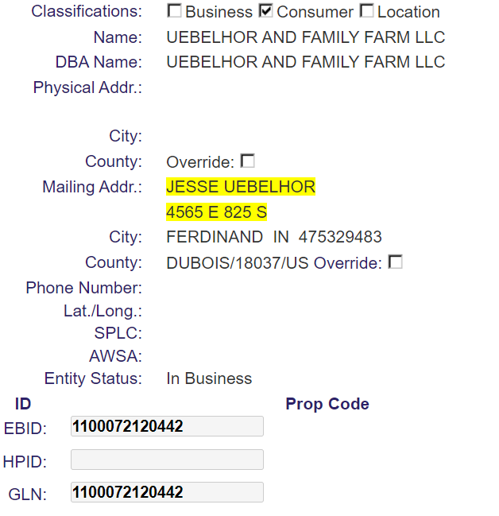
Entity Examples
Public Warehouse
Entity Scenario Submitted

Slide 20
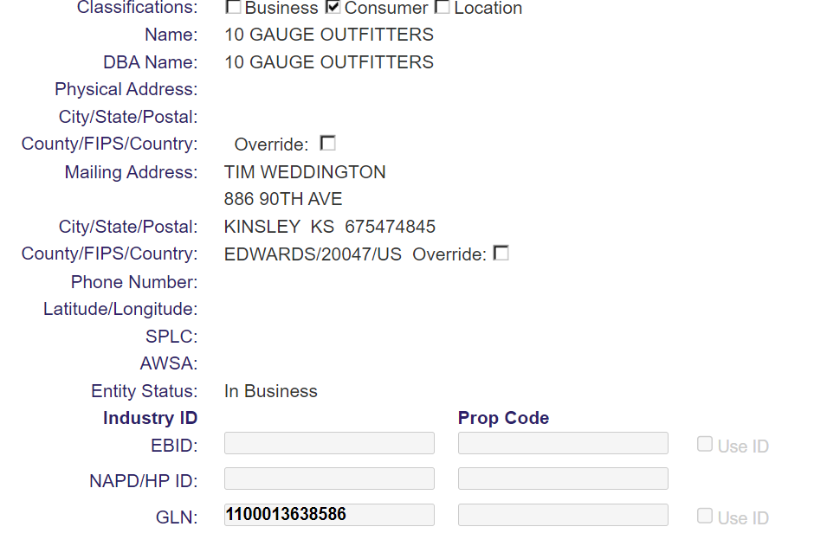
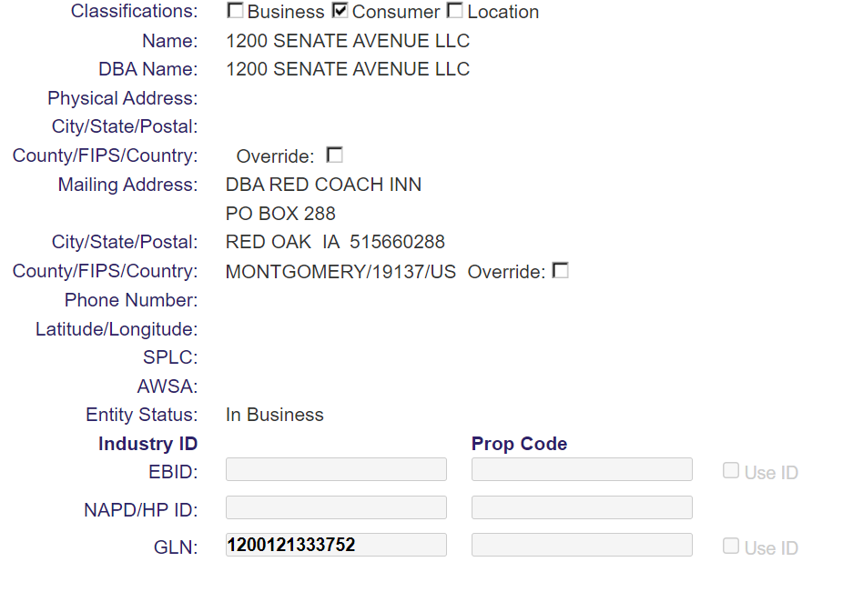
Entity Examples

Slide 21
Entity Scenario Discussion
An edit could be implemented “Do not only allow non-address information in physical or mailing address line 1”. Similar, to other data edits such as “S019 - Grower Last Name is 1 character in length and therefore invalid.”
A consideration would need to be in place for Public Warehouses
This would be applied to the web interface, website and webservices.
Need to develop a plan for clean-up for existing entities in AGIIS.
What are the next steps?
More research?
Create a PCR?

Slide 22
GS1 Update

Slide 23
Thank You!
For additional information: www.aggateway.org
Member Services at 866-251-8618 or Member.Services@AgGateway.org
Josh Wall, AGIIS Product Manager, AgGateway at 913-620-8434

Slide 24
Directory Oversight Committee Education

Slide 25
Ag Industry Identification System (AGIIS)
AGIIS is an interactive database that houses eBusiness data for agriculture.
AGIIS provides the unique identifiers and common data elements that allow companies to “sync” and set the stage for eBusiness transactions.
AGIIS does not process transactions; it is a directory resource that facilitates electronic communication.
Notes:
One of the most important AgGateway resources is AGIIS.
AGIIS is an interactive database that houses ag eBusiness data for industry subscribers.
Companies use the database to look up unique identifiers and common data elements (such as GTINs and GLNs) that they can then insert into their transactions — either internal or with trading partners — to make electronic communication possible.
For example, they can look up the Global Trade Item Number (GTIN), which is the numerical code representing a specific brand and packaging of a given product (e.g., seed, crop protection chemicals, fertilizer, etc.), or the Global Location Number, which is the unique identifier for the name and address of an organization, individual or location. Because trading partners are able to access and use the same identifiers, the pieces of information fit together, and electronic communication is possible.
AGIIS does not process transactions; it is a directory resource that facilitates electronic communication.

Slide 26
AGIIS Industry Owned and Managed Database
Products
Entities
Licenses
AGIIS
Notes:
This slide is a reminder to what unique identifiers AGIIS contains and provides a visual representation it also reinforces AGIIS is subscriber owned and subscriber maintained.
AGIIS is Created by the industry for the industry. I will mention products are maintained and added by product owners, entities maintained and added by the community of subscribers and licenses maintained and added by the Licensor.

Slide 27
AGIIS the Solution
Software and Business Logic
Communication
Accessibility
Notes:
Software and Business Logic – is at the core of the solution. I will discuss business rules and address standardization software is used.
Communication – notifications, extracts
Accessibility – web services, website, bulk processes

Slide 28
Who can access the data?
AGIIS
Full Subscriber
Search View
Non Subscriber
Notes:
Full View provides a Subscriber access to robust search criteria and all data elements and demographics associated with entity and product data.
Search View could include AgGatway non-members purchasing a search view subscription as well as all AgGateway Members are provided a subscription to AGIIS as a Member benefit.
Non Subscribers can access AGIIS through the Non-subscriber portal which has limited access just to view the identifiers and basic demographic information.

Slide 29
DOC Purpose
The Directory Oversight Committee – the DOC - is charged with establishing policies in the operation of AGIIS, the industry recognized repository of common entity and product information. We evaluate, prioritize, and execute enhancements in response to subscriber and AgGateway project requests. We oversee the maintenance and care of the data in the directory.

Slide 30
Guiding Documents
AGIIS Policy Document
Purpose
Definitions
Subscriptions
Non-Subscriber Access
Use of Data
AGIIS Data (Entity Enumeration, Verification, Users, Privileges)
AgGateway’s Responsibilities (Changes to AGIIS Functionality, Operating Rules, DOC Roles)
Directory Administrators Responsibilities
Member and User Responsibilities
Appendices (Subscriber Representation Matrix, Subscriber Agreement, Annual Maintenance)
AGIIS Operational Procedures Document
Purpose
Definitions
Procedures
Appendices
Notes:
Current (Dec 2021 – Feb 2022)
Dec – 5,882
Jan – 6,558
Feb – 4,983
Previous (Dec 2020 – Feb 2021)
Dec – 6,173
Jan – 5,225
Feb – 5,778

Slide 31
DOC Membership
Voting Membership
The Digital Resource Center will use the Subscriber Representation Matrix (Combination of Industry segment representation and organization's role in supply chain), to nominate candidates for voting seats on the DOC
3-year Terms
Current users familiar with AGIIS
Full AGIIS subscriber members of AgGateway
Subscribing companies – each company can only have one DOC rep
Non-Voting Membership
AgGateway staff representative(s)
Database hosting company representative
Advisory positions
Meetings
1 – 2 hour call each month
1 – 1 hour call each month as needed
Notes:
Current (Dec 2021 – Feb 2022)
Dec – 5,882
Jan – 6,558
Feb – 4,983
Previous (Dec 2020 – Feb 2021)
Dec – 6,173
Jan – 5,225
Feb – 5,778

Slide 32
Current DOC Membership

Slide 33
How we ensure quality
Notes:
I want to dive into the world of unique identifiers and the importance to eBusiness.

Slide 34
Strategy
System Edits
Member Services Support
Subscriber Support
Education

Slide 35
System Edits
Standard File Formats
Address Standardization (online and bulk)
Substandard data edits (name and address)
160 plus edits
Annual Maintenance
LACS/NCOA
Inactivating Entities with no Subscriber Cross-Reference
City/State Maintenance
Address Standardization
Entity De-duplication
Includes survivorship priority

Slide 36
System Edits - Continued
Address and Name matching (bulk)
Utilize matching software
Potential Duplicate detection (website and web services)
Exact Duplicate detection (website and web services)
Required fields enforcement
Example: Entities with a classification of a business require a physical address.
Entity Dispute Resolution process
If more than one subscriber requests a change to the same element(s) (name, address, location name, location description or phone) of an entity within a 60-day calendar period, the request will be in “dispute."
Notes:
Entity Dispute Resolution - If more than one subscriber requests a change to the same element(s) (name, address, location name, location description or phone) of an entity within a 60 calendar day period, the request will be in “dispute." The user who requests the second (or subsequent) change will be notified of the dispute via a web page warning and a notification included in the existing “request submission” email confirmation. Member Services will verify the disputed fields based on the current verification processes. The user who submitted the disputed request will be notified of the resolution in the existing “request resolution email”. If the dispute is accepted, all subscribers with the entity in their subset will be notified of the change in their entity update extract.

Slide 37
Member Services Support
Verification
Tier 1 – Internet Searches
Tier 2 – Phone or email
Address Override review
Exact Duplicate detection review
Add requests
Reported Duplicate review
Survivorship rules
Business Rule Review
Data Harvesting
Results emailed
Entity Dispute Resolution process
Member Services verify the disputed fields based on the current verification processes.
Chris Nikki Kimberly

Slide 38
Subscriber Support
Submission of quality data
Establish Standards when sending data to AGIIS
Establish an internal identifier to industry Identifier x-ref
Establish an Entity Update Process
Subscriber Owned locations (GS1 Prefix)
Self Verified
Verified by the entity themselves or an authorized source
Providing updates (entities and products)
Notifying Product owners of inaccurate data
Applying entity updates to internal systems
Subscriber Synchronization
Duplicate Reporting
Notes:
Establish Standards when sending data to AGIIS such as:
Name field – last, first, middle, (Avoid submitting substandard data such as cash sales, non exempt, COD)
Address Line 1 & Line 2 – Need a valid complete address
City, State, Zip Code – Appropriate field sizes, valid
Phone number - (913) 469-8700 (field size, what can be entered). When asking for verification please provide valid phone information
Utilize data hygiene tools and standards within internal systems
Establish an Entity Update Process such as:
Determine which internal data field should be synchronized with AGIIS
Determine which AGIIS field can be applied automatically and which need to be reviewed manually
Approximately 400 duplicate requests have been reported in the last 6 months.

Slide 39
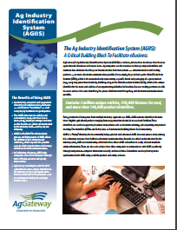
Education
AgGateway Newsletter
AgGateway Website
White Papers
AGIIS Duplicate Prevention
AGIIS Entity Synchronization
AGIIS Product Synchronization
AGIIS Fact Sheet
Release Notes
Detailed information regarding new enhancements
Released each time an enhancement occurs
Page level help
Provides detail of every field on the page
Provides tips and tricks on how to navigate the page
Provides details and examples of what needs to be populated in fields
Hover help is used on fields to aid users
Tutorials
Tutorials are located under “Help” on the Menu Bar
Covers – General overview, Entities, Products, Admin

Slide 40
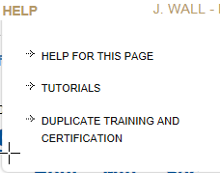
Education - Continued
Online Duplicate Training and Certification
Educates users on AGIIS Business rules
Informs users on how to identify and report a duplicate
Certify users to report duplicates

Slide 41
Education - Continued
Subscriber Training
Website Tour for Subscriber administrators and users
Web Meetings
Product loads
Entity bulk loads
Extracts
ebMS profiles
Web Service implementation
Review of existing functionality
Maintaining Subscriber profiles and users
Project Support
AGIIS Overview
Project Support
Conference Training
Annual
MYM
Member Services
866-251-8618 or Member.Services@AgGateway.org
Covers – General overview, Entities, Products, Admin
Notes:
Current (Dec 2021 – Feb 2022)
Dec – 5,882
Jan – 6,558
Feb – 4,983
Previous (Dec 2020 – Feb 2021)
Dec – 6,173
Jan – 5,225
Feb – 5,778

Slide 42
Thank You!
For additional information: www.aggateway.org
Member Services at 866-251-8618 or Member.Services@AgGateway.org
Josh Wall, AGIIS Product Manager, AgGateway at 913-620-8434

