Slide 1
AGIIS “101” Education Session
November 14, 2022
Josh Wall, AGIIS Product Manager

Slide 2
Overview…
Introduction
AGIIS “The Industry Solution”
How it Works
What’s New and Coming soon?
Questions?
Notes:
This slide provides an overview of the topics we will discuss.

Slide 3

Ag Industry Identification System (AGIIS)
AGIIS is an interactive database that houses eBusiness data for agriculture.
AGIIS provides the unique identifiers and common data elements that allow companies to “sync” and set the stage for eBusiness transactions.
AGIIS does not process transactions; it is a directory resource that facilitates electronic communication.
Notes:
One of the most important AgGateway resources is AGIIS.
AGIIS is an interactive database that houses ag eBusiness data for industry subscribers.
Companies use the database to look up unique identifiers and common data elements (such as GTINs and GLNs) that they can then insert into their transactions — either internal or with trading partners — to make electronic communication possible.
For example, they can look up the Global Trade Item Number (GTIN), which is the numerical code representing a specific brand and packaging of a given product (e.g., seed, crop protection chemicals, fertilizer, etc.), or the Global Location Number, which is the unique identifier for the name and address of an organization, individual or location. Because trading partners are able to access and use the same identifiers, the pieces of information fit together, and electronic communication is possible.
AGIIS does not process transactions; it is a directory resource that facilitates electronic communication.

Slide 4

Why AGIIS ?
Regulatory Environment
Consumer Interests
Consolidation
Shifting Markets and Value
Consistent Standard Identification
Information Exchange
Notes:
Provide commentary around common business challenges in Agriculture.
I want to let the audience know that business challenges brought companies together to develop tools such as AGIIS to better handle these business issues. I believe the audience will be able to relate with one of the challenges listed.
Regulatory Environment
Federal as well as state and locality requirements
Uncertainty as to future direction
Consumer Interests
Product recalls due to disease or contamination
Desire to know where food comes from
Organic and sustainable practices
Consolidation
Businesses merging systems, records and personnel
International reach lengthens supply chains and requires improved planning
Fewer farmers but greater demand for services and support
Shifting Markets and Value
Reduced margins
Increased complexity
Less business process automation in some industries (i.e. seed)
Increased risk and increased cost as more information is required but infrastructure to identify it is not in place
Consistent Standard Identification
What is important? What is required? What is extraneous?
Technologies exist but processes and practices are not consistent

Slide 5

AGIIS Identifiers – Provides Solutions
Sales Reporting
Regulatory Compliance
Supply Chain eConnectivity
Precision Ag Field Operations
Business Analysis
Connecting the Industry Together
Notes:
Sales Reporting – Crop Protection, Specialty and Seed Industry for Rebate Programs
Regulatory Compliance – Seed License Reporting for EPA. ResponsibleAg Program for Crop Nutrient Industry, Data Privacy enhancement for CCPA
Supply Chain eConnectivity – Ship Notice, Delivery Confirmation, Inventory, Invoicing
Precision Ag Field Operations – Machine Reference Data potentially Field Identification.
Connecting the Industry Together – Provides Unique Identification for the entire industry so they can be connected which enable tracebility
Business Analysis – Allows for business analysis to be conducted with ease internally and externally

Slide 6
AGIIS Industry Owned and Managed Database
Products
Entities
Licenses
AGIIS
Notes:
This slide is a reminder to what unique identifiers AGIIS contains and provides a visual representation it also reinforces AGIIS is subscriber owned and subscriber maintained.
AGIIS is Created by the industry for the industry. I will mention products are maintained and added by product owners, entities maintained and added by the community of subscribers and licenses maintained and added by the Licensor.

Slide 7
AGIIS Snapshot
As of November 7, 2022
5.6 Million Active Entities (GLNs)
240,498 Products (GTINs)
672,151 Licenses
142 Subscribers
Notes:
As of 11/7/2022
5,614,031 Entities
672,151 Licenses
240,498 Products
142 Subscribers

Slide 8

How does it work?
Notes:
In this section we will begin discuss the identifiers that are supported within AGIIS, How the system operates and how subscribers use the system.

Slide 9
Subscribing to AGIIS
www.AgGateway.org
  Click on “Join Us” and then “Subscribe to AGIIS”
  Download and sign the AGIIS Subscriber’s Agreement
  Download and complete the AGIIS Enrollment Form
  Email both forms to Member.Services@AgGateway.org
  Member Services will complete initial user setup and your designated Subscriber Administrator will complete the set up for additional users in your organization

Slide 10

About GS1 US
GS1 US® serves more than 300,000 businesses across 25 industries in the United States.
Administrating the GS1 System of Standards
Providing support services, tools, education, and training
International Standards Organization
AgGateway has built a strong relationship with GS1 U.S. for over 16 years
Agreement with GS1 U.S. for AGIIS to assign GLN’s
GS1 US is the pioneer of the Universal Product Code (U.P.C.) and the Electronic Product Code (EPC®).

Slide 11




Identify, Capture & Share in the Supply Chain
GS1 Standards make it possible to identify, capture, and share information automatically and accurately about products, business locations, and more. This way anyone who wants that information can understand it,
no matter who or where they are.
Identify
Capture
Share

Slide 12

The Global Language of Business
GS1 Standards
Identify GS1 Identification Numbers
Companies, Products, Locations, Logistics, Assets,
and Services
Capture GS1 Data Carriers
Barcodes and EPC®-enabled RFID
Share GS1 Data Exchange
Master Data, Transactional Data, and Physical Event Data

Slide 13

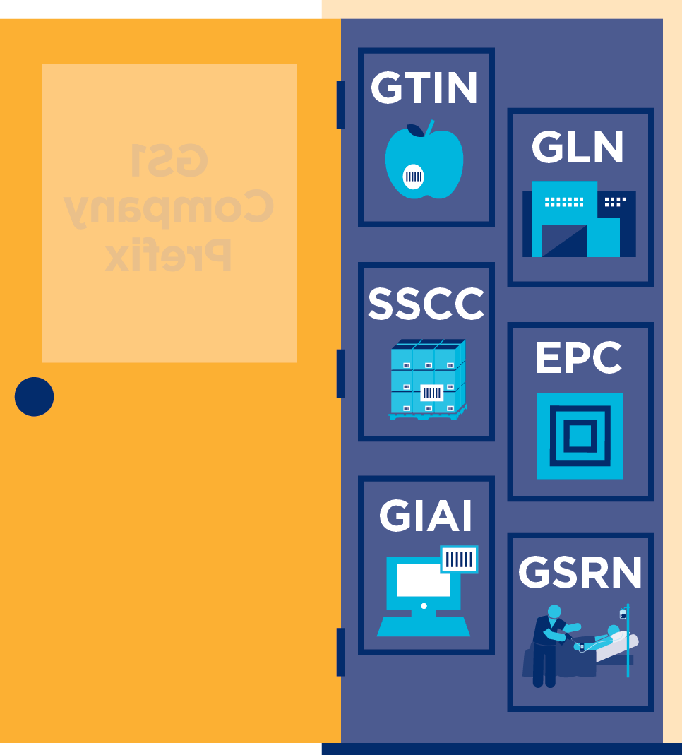
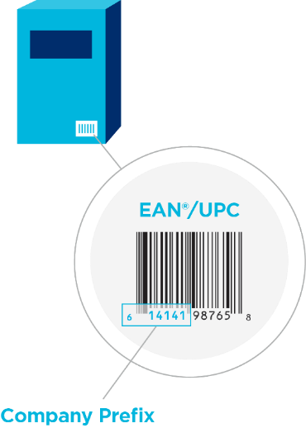
Where It All Starts

Slide 14
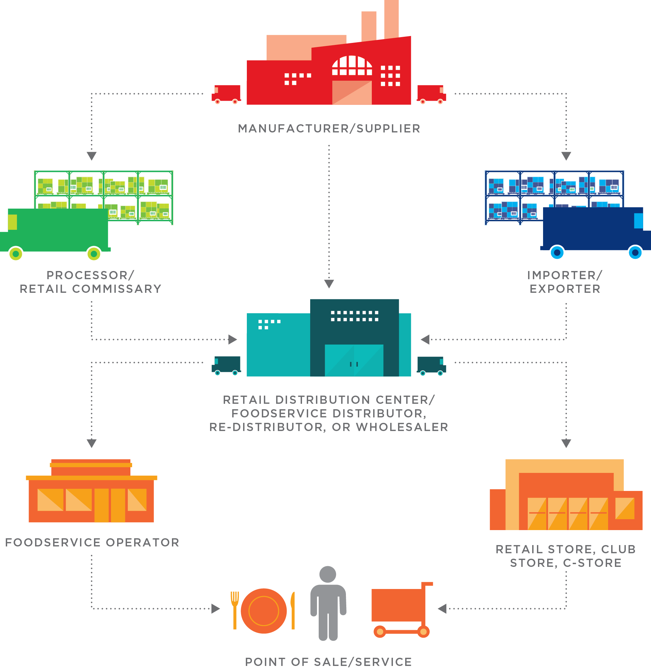


Identify: Unique Identifiers
GTIN – Global Trade Item Number
  Used to identify products at the lowest salable unit
  Assigned by product owner and displayed in AGIIS
GLN – Global Location Number
  Used to identify entities (Businesses, Consumers, Locations)
  All active entity records in AGIIS have a GLN identifier.
GTIN 00707755364158
GLN 0707755000068
GLN 1100012809673
Notes:
I want to quickly introduce the identifiers AgGateway supports. Will explain entities cover businesses, consumers and locations.

Slide 15
What is being Identified?
Who/Where? (GLN)
  Manufactured a Product or Supplied a Service
  Sold a Product/Service
  Purchased a Product/Service
  Field identification
  Applied/Planted Product
  Received a Service (spray application or grid sampling)
  Shipped a Product
What? (GTIN)
  Product identified by a GTIN number
Notes:
The purpose of the slide is to demonstrate to the audience how identifiers are used in business transactions.

Slide 16

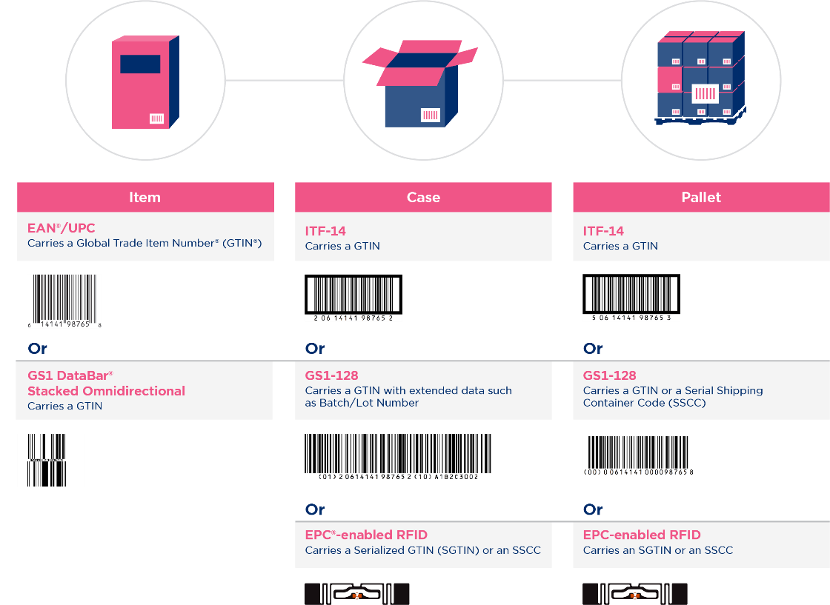
Capture: GS1 Data Carriers
GS1 Data Carriers are capable of holding varying amounts of data to accommodate different needs such as Batch/Lot information and expiration dates.

Slide 17

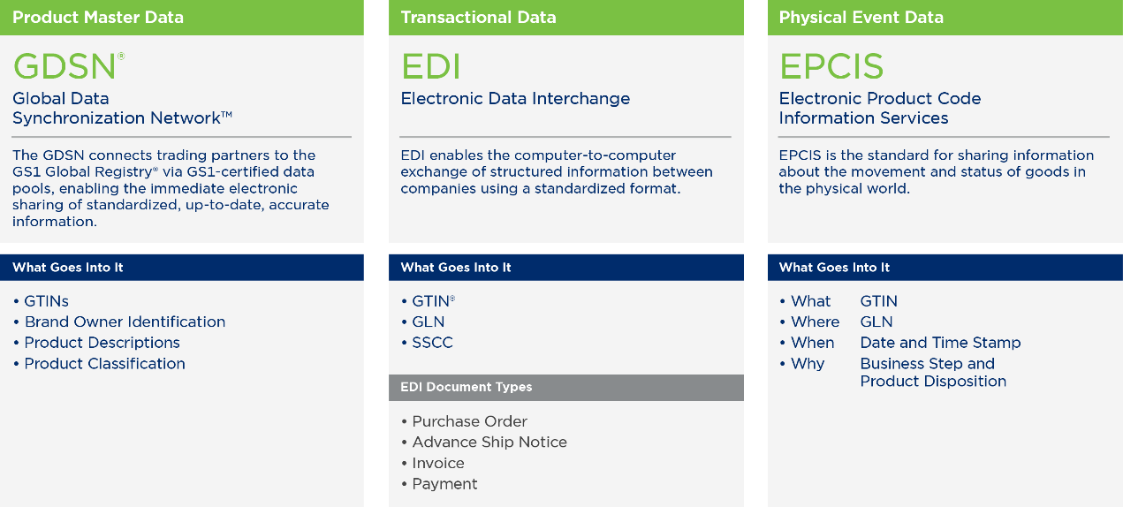
Share: GS1 Data Exchange
Interoperability, made possible by identification standards,
data capture standards, and data exchange standards, allows product information to flow through the supply chain.

Slide 18


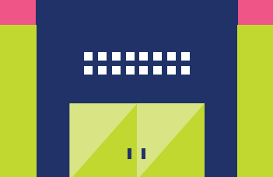

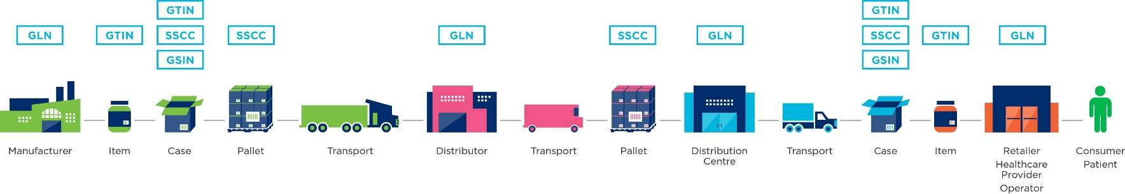
Importance of Unique Identification
Unique identification of products and locations is the foundation for visibility across supply chains.
Global Trade Item Number®
(GTIN®) is used to uniquely
identify a trade item.
Global Location Number (GLN)
is used to uniquely identify a
location or stakeholder.
Distribution Center

Slide 19
AGIIS the Solution
Software and Business Logic
Communication
Accessibility
Notes:
Software and Business Logic – is at the core of the solution. I will discuss business rules and address standardization software is used.
Communication – notifications, extracts
Accessibility – web services, website, bulk processes

Slide 20
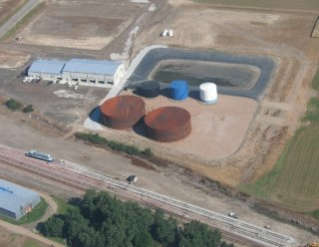
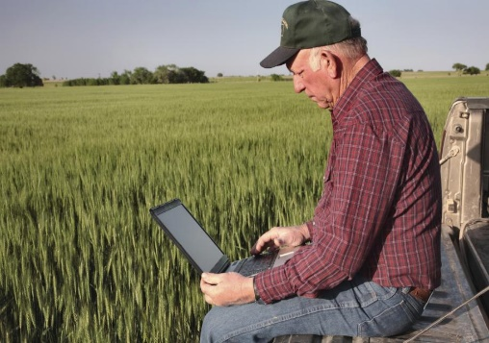
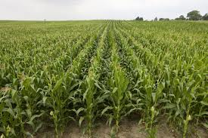
Entities in AGIIS
Consumer
Business
Location
Notes:
Will explain the different type of entities in AGIIS.

Slide 21
Entity Basics
Definition – An Entity is a separate and distinct Individual, Business or Location for which one or more unique industry identifiers have been assigned.
Entity records are added and maintained by the AGIIS user community
  On the AGIIS website
  Web Services
  Bulk file processes
All AGIIS Subscribers have access to view all entity records in the AGIIS directory using the AGIIS website or web services
Notes:
This slide introduces Entity portion of AGIIS and let’s the audience know AGIIS is a subscriber driven database which means it is maintained and updated by the subscriber community. It is important as a subscriber of AGIIS that data quality and accuracy is considered before adding and updating the database.

Slide 22
Business Entity Data - Key Elements
Global Location Number
Company Name
Doing Business as Name
Physical Address
Mailing Address
Phone Number
Latitude/Longitude
Entity Classification
Business Status
Verification Status

Slide 23
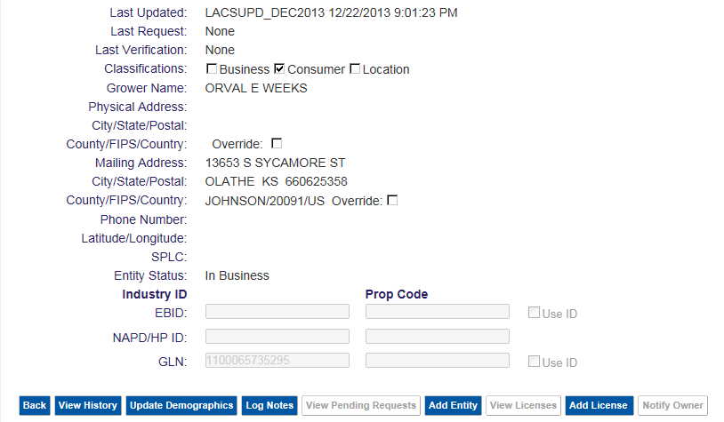
Entity Basics
Notes:
This provides the audience of a screen shot of the AGIIS Directory. We will discuss fields on the slide but particularly Industry Identifier section which will set-up the next two slides discussing entity subsets.

Slide 24
Entity Subsets
An entity subset is established by a subscriber linking their internal identifier or prop code to an AGIIS entity record’s GLN identifier
Creating an entity subset indicates that you have an interest in specific entity records and identifiers
You can only update a record if it is in your subset
Once your entity subset is created, you can get an GLN Update Extract file that will indicate any changes that have been made to any entity record in your subset
Notes:
AGIIS Subscribers (excluding subscribers with only search/view privileges) can include any entity record in their subset.

Slide 25
AGIIS Entity Process
Imports
Subscriber Subsets
Extracts
Internal
Systems
DEF
Entity Bulk File
GLN Add/Update
Business
Rule
Layer
DEF
Subset
DEF GLN Update Extract
DEF
DB
AGIIS
XYZ
AGIIS Website
Add/Update
XYZ
Subset
XYZ GLN Update Extract
XYZ
DB
ABC
AGIIS Webservice
Add/Update
ABC
Subset
ABC GLN Update Extract
ABC
DB
DEF
Subset
DEF GLN Update Extract
DEF
DB

Slide 26
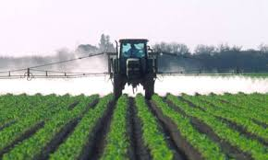
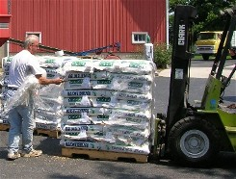
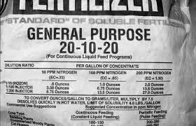
Product in AGIIS
Crop Protection
Seed
Crop Nutrient

Slide 27
Seed Product Data - Key Elements
Global Trade Item Number
Product Category
Product Name
Brand
Crop
Variety/Hybrid
Maturity/Zone
Seed Size
Status (at each level)
Unit of Measures (at each level)

Slide 28
Product Process: Example
Ag Industry via AGIIS
Website and Web Services
Subscriber
A
Loads Products
Subscriber A
Extract
Business Rules , Verification
and UOM Standardization
AGIIS Products
Subscriber
B
Loads Products
Subscriber
B
ebMS updates
Subscriber A Subset
Subscriber B Subset
Notes:
This high level process flow illustrates how product information flows through the system.

Slide 29
The Value of Identification
Improves product position and visibility
Enables company to identify, capture, and share information about products, business locations, and more
Trading Partners use same identifiers for products and entities to ensure accuracy of delivery, billing and other E-business transactions
Aides and enables the automation of business processes
Reduces cost as standard schemes are implemented
Mitigates risk of incorrect or erred compliance reporting
Increases efficiency of field operations
Notes:
When organizations integrate Unique Identifiers into their business operations they begin seeing immediate value.
Unique IDs..
Improves product position and visibility
Enables company to identify, capture, and share information about products, business locations, and more
Trading Partners across the ag industry use same identifiers for products and entities to ensure accuracy of delivery, billing and other E-business transactions
They help aid and enables the automation of business processes
They help reduce cost as standard schemes are implemented
The help mitigate the risk of incorrect or erred compliance reporting
Increases efficiency of field operations

Slide 30

What’s New
Disaster Recovery Plan and annual exercise completed (8/29-9/1)
Password Management Enhancement (SOW Released 4/9)
“Member Services Reviewed” functionality (PCR 241 released 7/2)
GLN Non-Reuse Enhancement (PCR 242 released 7/2)
Entity Response Notification Enhancement (PCR 244 released 9/30)
Two Factor Authentication Enhancement (PCR 243 released 10/22)

Slide 31

What’s Coming Next
Annual Maintenance Weekend of 3 December 2022
    LACS & NCOA Processing
    Inactivating entities with no subscriber cross reference
    City/State Review
    Address Standardization Update
    Annual Deduplication (Weekend of 17 December 2022)
AGIIS Product Directory Enhancement
  Result of Crop Protection Product Guidelines Working Group 16 (WG16)
API Implementation Discovery
  Understanding Current Subscriber API Usage and Needs
  Understanding Future API Usage and Needs
Subscriber Enhancements are always welcome

Slide 32

Continuous Improvement Process
Subscriber Input
Formal Request Process
Directory Oversight Committee
Notes:
We Can discuss which image you like
Will discuss the structure of the Directory Oversight Committee (DOC)
Representation from each AgGateway Council
Role of DOC
Evaluating enhancement, change or other modification requests, wherever the request comes from, against the purpose of AGIIS and the mission of AgGateway
Ensuring data cleanliness and maintenance as defined in the AGIIS Policies and Procedures documents is implemented
Communicating needs and relevant messages between councils and the committee
Subscriber Input
Each AgGateway Member Company or Subscribing Company can recommend an improvement or enhancement to AGIIS
Formal Request Process
- Discuss a form is submitted to Member Services and then passed on to Directory Oversight Committee for evaluation and prioritization

Slide 33
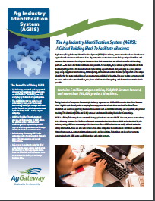
AGIIS Support
AgGateway Newsletter
AgGateway Website
White Papers
  AGIIS Duplicate Prevention
  AGIIS Entity Synchronization
  AGIIS Product Synchronization
  AGIIS Fact Sheet
Training
  Web Meetings
  Project Support
Tutorials
  Covers – General overview, Entities, Products, Admin
Member Services
  866-251-8618 or Member.Services@AgGateway.org

Slide 34
Thank You!
For additional information: www.aggateway.org
Member Services at 866-251-8618 or Member.Services@AgGateway.org
Josh Wall, AGIIS Product Manager, AgGateway at 913-620-8434

