Slide 1
Mid-Year Meeting
Communications Committee
June 13, 2017
3:40 – 5:20

Slide 2
Agenda
Review of AgGateway Guidelines
Welcome and Roll Call/Introductions
Approval of Prior Meeting Minutes

Slide 3
Agenda
Old Business
New Business
Review Action Items
Committee Plan Update
Marketing Plan Update
July Newsletter Topics
September Newsletter Topics
Council & Working Group Updates
Review Social Media Assignments

Slide 4
Agenda
Social Media and Analytics
Social Media Platform, Website and Google Analytics
Social media insights and learnings from Social Media Marketing World 2017
Guidelines development for Social Media Task Force

Slide 5
AgGateway Antitrust Guidelines
While some activities among competitors are both legal and beneficial to the industry, group activities of competitors are inherently suspect under the antitrust laws. Agreements or combinations between or among competitors need not be formal to raise questions under antitrust laws, but may include any kind of understanding, formal or informal, secretive or public, under which each of the participants can reasonably expect that another will follow a particular course of action.
Each of you is responsible to see that topics, which may give an appearance of an agreement that would violate the antitrust laws, are not discussed at your meetings. It is the responsibility of each participant in the first instance to avoid raising improper subjects for discussion. This reminder has been prepared to assure that participants in meetings are aware of this obligation.
A copy of the Antitrust Guidelines must be provided at every meeting to its participants. If meeting is via telephone, an electronic form must be sent to its participants prior to the conference call.

Slide 6
Introductions &
Roll Call

Slide 7
Introductions
Name
Company
Title
Time in AgGateway
Hoping to get out of the MYM

Slide 8
Old Business

Slide 9
Committee Overview
The committee seeks to communicate to members, potential members and the industry the benefits of involvement in AgGateway and eBusiness. The committee is responsible for managing the monthly newsletter, website and social media, as well as reviewing and contributing to annual communications plans.
The committee is involved in all efforts to spread the word about upcoming activities, AgGateway successes and future projects. We also provide support to councils and other AgGateway groups, particularly to the membership and conference committees.

Slide 10
Review Action Items
J. Nolfo to turn in the meeting descriptions for the Mid-Year
J. Nolfo reach out to Jody Costa to see if we can produce some analytics at the Mid-Year
All Social Media Task Force members to add Social Media into their calendars.

Slide 11
Committee Plan Review
Operations
  Get a Vice-Chair
    Not Complete
  Fill all Council/Working Group/Committee Liaisons
    Mostly Complete
      Councils
        Seed Council: Natasha Lilly
        Ag Retail Council: Natasha Lilly
        Crop Nutrition Council: Sarah Koehn
        Specialty Chemical Council: J. Nolfo
        Crop Protection Council: Eileen Licitra
        Precision Ag Council: Susan Ruland
        Allied Providers Council: Jody Costa, Shane Snyder
        Grain & Feed Council: Natasha Lilly

Slide 12
Committee Plan Review
Operations (Con’t)
      Committees and Working Groups:
        Conference Committee: Kristin Nottingham
        Membership Committee: Shane Snyder
        SPADE Task Force:
        SPADE Communications Task Force:
  Increase membership size of Communications Committee
    Added at least two members

Slide 13
Committee Plan Review
Social Media
  Increase interaction with social media platforms, especially LinkedIn Group and Twitter
Newsletter
  Leadership Profile in each newsletter
  Each Council have at least two significant update article
  Each Committee have at least 1 significant update article

Slide 14
Communications Committee
Plan Update for 2nd Half of 2017
Susan Ruland, Communications Director
June 13, 2017

Slide 15
Promotional Focus – Q3 & Q4
Ag Retail
  Post-seminar – eConnectivity resources and case studies/testimonials, follow-up press release, incl. promotion of new video, media articles (AgPro, Successful Farmers, etc.), CLA, ARA and ASTA newsletters
  Sales reporting file format – case study? Promotion
  ARA meeting – late Nov./early Dec.
ADAPT Framework
  Defining minimum viable product (MVP)
  InfoAg – St. Louis July 26-27
  Press release, guest column, flyer, web section
Specialty Chemical
  Joint promotion with Seed Council with new Inventory Flat File format, incl. press release, webinar, web page, possible flyer.

Slide 16
Promotional Focus – Q3 & Q4
Seed Council
  Promote Seed value calculator
  Joint promo w Specialty Council on inventory file format
  Possible activities with ASTA
Crop Nutrition
  Promote new OrderCreate standard – press release, news article
  ResponsibleAg initiative?
Precision Ag
  New PAIL standard – press release, flyer
  SPADE3 Deliverables – promote as released

Slide 17
Promotional Focus – Q3 & Q4
Other
Communications Kit in conjunction with “c-suite” kit.
Annual report
Annual conference promotion
  Quick Connect concept (Seed)
  Awards programs (Ron Storms, AgGateway in Action)
Resources video promo
Possibly - Allied Providers tech & service directory
Explore graphic video concept

Slide 18
July Newsletter
AgGateway Newsletter Articles | AgGateway Newsletter Articles
Due Date | 14 Jun 2017
Title/Subject | Author
Leadership Profile: | J. Nolfo
New Member Article | Natasha Lilly
AgGateway In The News | Kristin Nottingham
AIDC Working Group | Jody Costa
AGIIS | Chris Crutchfield/ Josh Wall
AgGateway Resources and Testimonial Video | Susan Ruland
Mid Year Meeting In Review | Kristin Nottingham
AgGateway to Careers | Kristin Nottingham

Slide 19
New Business

Slide 20
August Newsletter
AgGateway Newsletter Articles | AgGateway Newsletter Articles
Due Date | 14 Jul 2017
Title/Subject | Author
eConnectivity Matters | Wendy Smith
New Member Article: | Natasha Lilly
AgGateway in the News | Kristin Nottingham
Leadership Profile: | J. Nolfo
AIDC Working Group | Jody Costa
AGIIS | Chris Crutchfield / Josh Wall
Council Updates | Kristin Nottingham

Slide 21
Council & Working Group Updates
Councils:
  Seed Council: Natasha Lilly
  Ag Retail Council: Natasha Lilly
  Crop Nutrition Council: Sarah Koehn
  Specialty Chemical Council: J. Nolfo
  Crop Protection Council: Eileen Licitra
  Precision Ag Council: Susan Ruland
  Allied Providers Council: Jody Costa, Shane Snyder
  Grain & Feed Council: Natasha Lilly

Slide 22
Council & Working Group Updates
Committees and Working Groups:
  Conference Committee: Kristin Nottingham
  Membership Committee: Shane Snyder
  SPADE Task Force:
  SPADE Communications Task Force:

Slide 23
Social Media Calendar
Listing of who is responsible for what week until next Communication Committee Meeting
  Week of 6/19: Natasha Lilly
  Week of 6/26: Susan Ruland
  Week of 7/3: J. Nolfo

Slide 24
Other Discussion Items
For other committee members to address topics not covered.

Slide 25
Social Media and Analytics

Slide 26
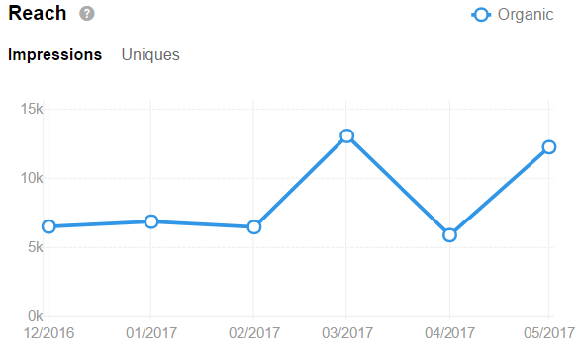
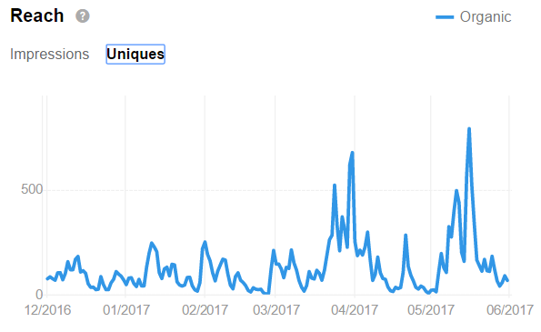
LinkedIn Analytics - Reach

Slide 27
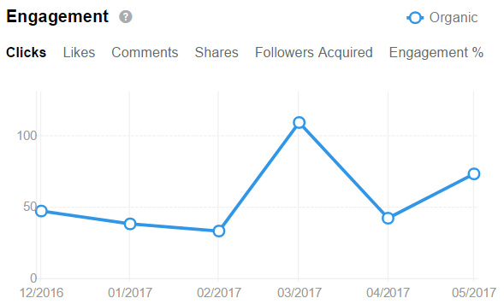
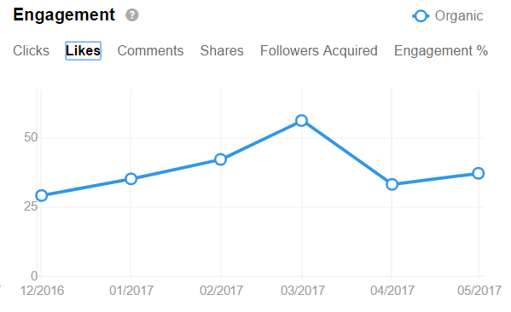
LinkedIn Analytics Engagement

Slide 28
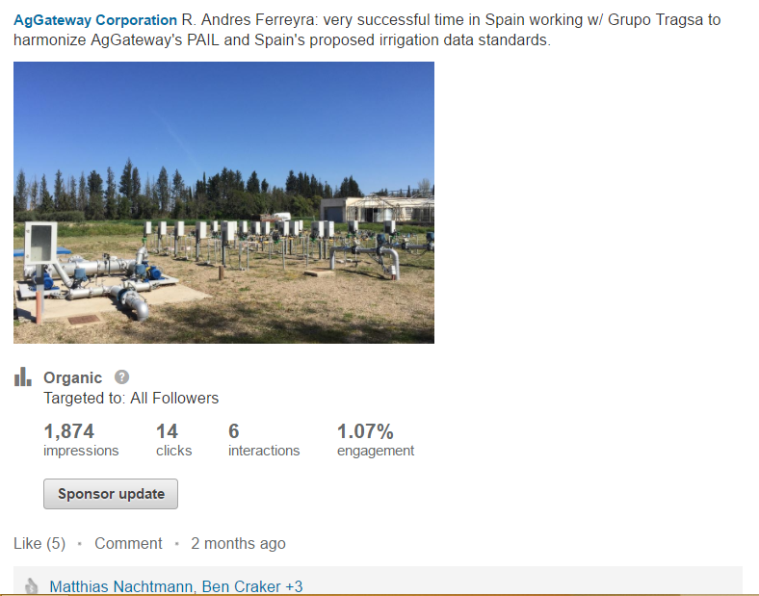
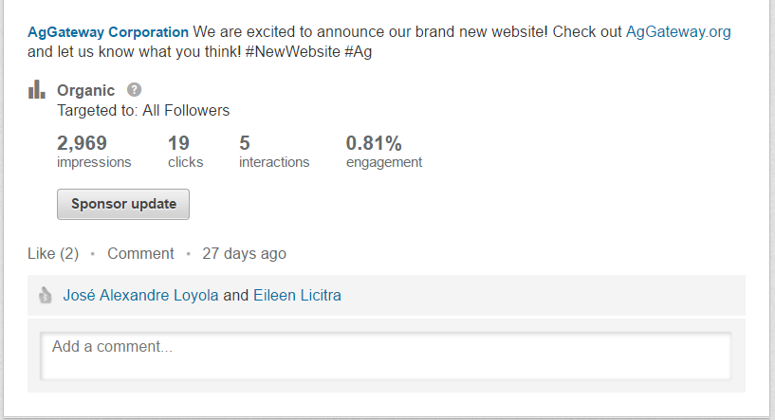
LinkedIn Analytics –
Top Post Samples

Slide 29
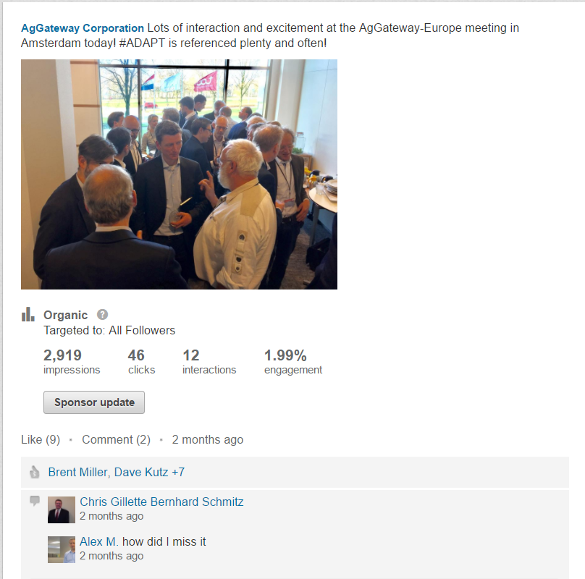
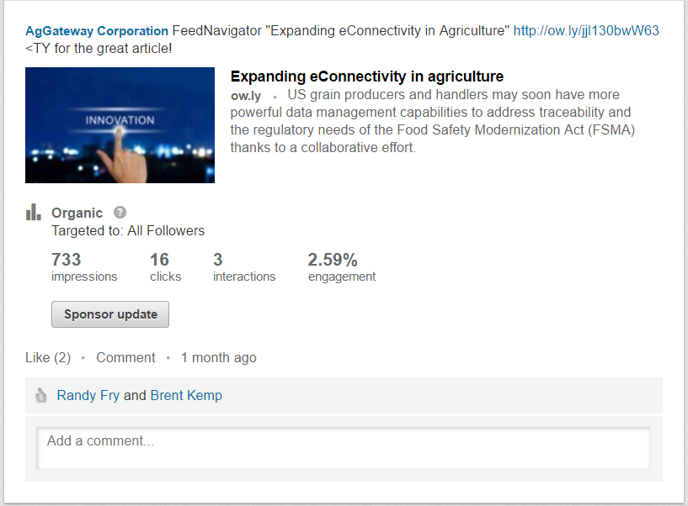
LinkedIn Analytics –
Top Post Samples

Slide 30
LinkedIn Group Analytics

Slide 31
Twitter Analytics

Slide 32
Twitter Analytics
Tweets vs New Followers
Tweet Impressions to New Followers

Slide 33
Twitter Analytics
Tweet Impressions to Profile Visits

Slide 34
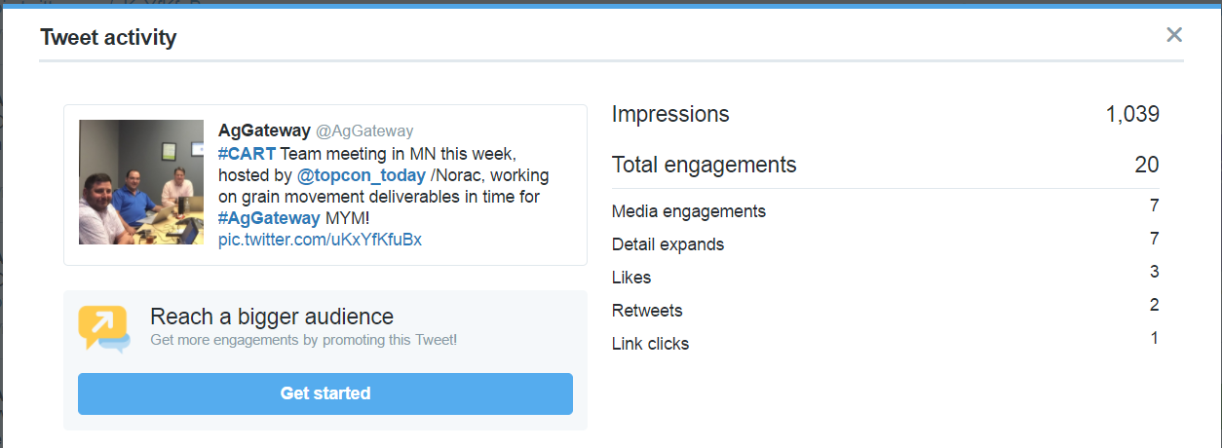
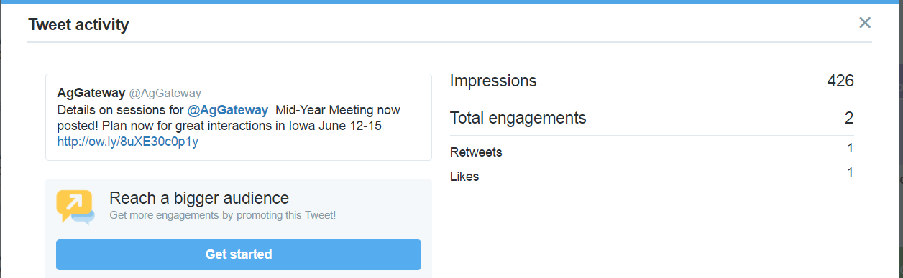
Twitter Analytics – Top Tweets

Slide 35
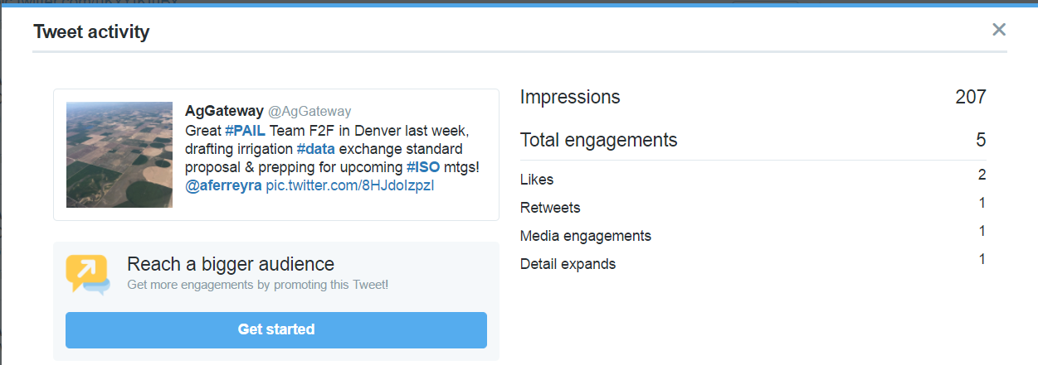
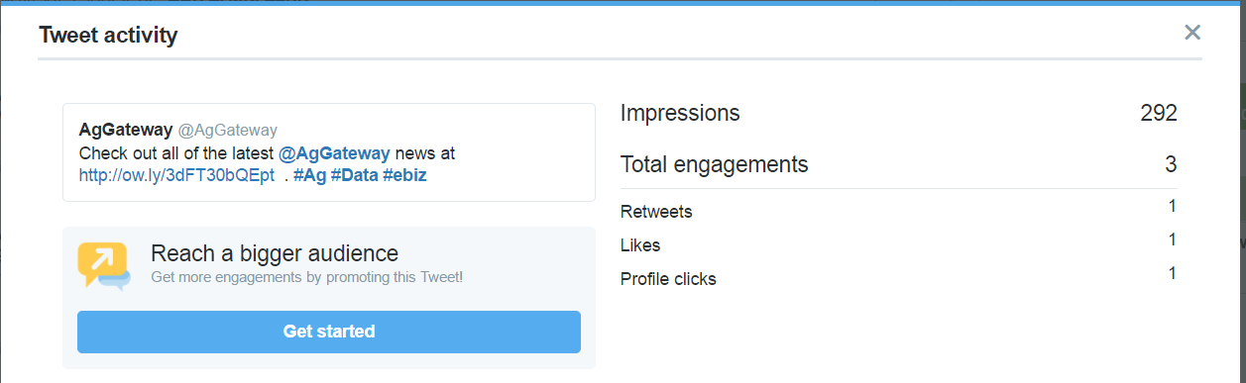
Twitter Analytics – Top Tweets

Slide 36
Website Analytics
To Be Determined…Further review at Yearly Conference

Slide 37
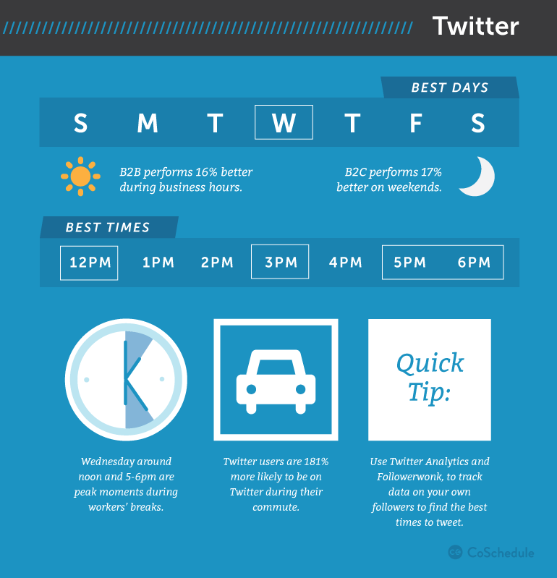
Best times to post - Twitter
The optimal times to tweet are 12–3 p.m., with a peak best time at 5 p.m. During the workweek is the best, though some niches might have more active audiences on the weekend.
  Wednesday at noon and 5–6 p.m.
  Monday–Friday at 12–3 p.m. and 5 p.m.
  Experiment with 2–3 a.m., 6–7 a.m., and 9–10 p.m.
When to tweet in general to increase retweets and clickthroughs:
  5–6 p.m.
  Noon specifically
  3 p.m.
https://coschedule.com/blog/best-times-to-post-on-social-media/

Slide 38
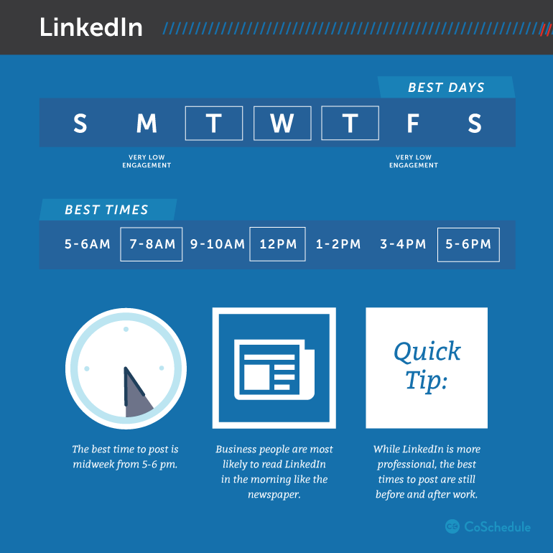
Best times to post - LinkedIn
Midweek posting is optimal from 5–6 p.m.
  Tuesday at 10–11 a.m.
  Tuesday, Wednesday, and Thursday at 7:30–8:30 a.m., 12 p.m., and 5–6 p.m.
When to post on LinkedIn to get the most clickthroughs:
  5–6 p.m.
  7–8 a.m.
  12 p.m.
https://coschedule.com/blog/best-times-to-post-on-social-media/

Slide 39
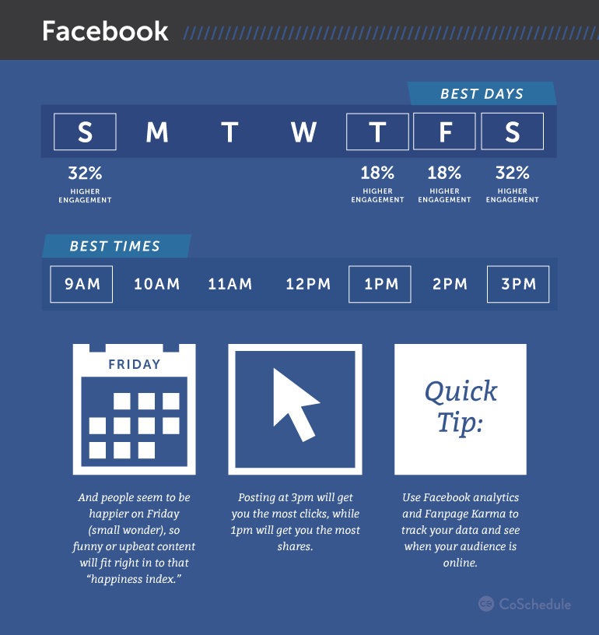
Best times to post - Facebook
The best time to post on Facebook is 1–4 p.m. late into the week and on weekends.
  Saturday and Sunday at 12–1 p.m.
  Thursday and Friday at 1–4 p.m.
  Wednesday at 3 p.m.
When to post on Facebook in general to increase your shares and clickthroughs:
  1 p.m.
  3 p.m.
  9 a.m.
https://coschedule.com/blog/best-times-to-post-on-social-media/

Slide 40
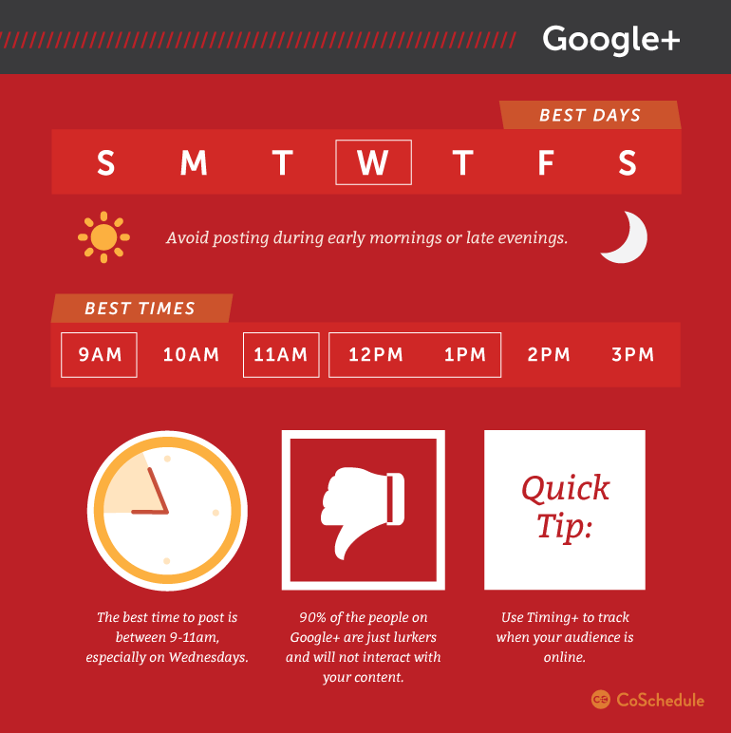
Best Times to Post – Google+
The beginning of the workday morning is optimal for Google+.
  Wednesday at 9 a.m.
  Weekdays at 9–11 a.m.
When to post on Google+ in general:
  9 a.m.
  11 a.m.
  12–1 p.m.
https://coschedule.com/blog/best-times-to-post-on-social-media/

Slide 41
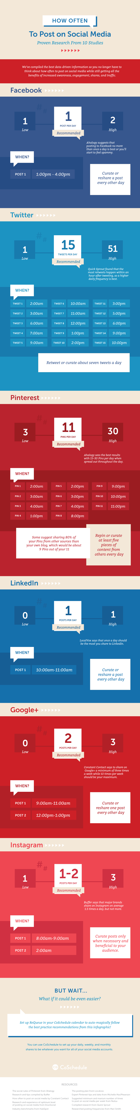
Posting Frequencies
https://coschedule.com/blog/how-often-to-post-on-social-media/

Slide 42
Posting Frequencies
https://coschedule.com/blog/how-often-to-post-on-social-media/

Slide 43
Posting Frequencies
Facebook
  According to a study from Hubspot.com, if you have smaller following, posting twice a day will actually result in about 50% fewer clicks per post.
  This means that, your total number of clicks will still be higher than if you were posting only a few times a week, but your engagement per post will be reduced.
  Conversely, if you post a mere 1-5 times a month, your clicks per post will almost double. This is one of the fastest ways to get more traffic to your site, set a goal and get posting.
https://www.forbes.com/sites/neilpatel/2016/09/12/how-frequently-you-should-post-on-social-media-according-to-the-pros/2/

Slide 44
Posting Frequencies
Twitter
  The ideal number of times to tweet per day depends almost entirely on your goals. For example, if you are looking to optimize your engagement per tweet, then 1-5 tweets per day is where it’s at.
  However, if you want to generate more total responses, then you can tweet your heart out. The study found that even tweeting 50 times a day did not have any adverse effects on your account!
    However, it is important to keep something in mind when it comes to your Twitter marketing. If you are spending hours each day writing out 50 tweets, those are hours that could be spent on activities that do more to drive up the bottom line.
  While you certainly can focus your Twitter marketing on generating a massive number of responses, I recommend you focus on engagement.
  1-5 tweets a day will not take too much time, will increase audience engagement, and will leave you with the time you need to focus on more important parts of your business.
https://www.forbes.com/sites/neilpatel/2016/09/12/how-frequently-you-should-post-on-social-media-according-to-the-pros/2/

Slide 45
Guidelines Development for
Social Media Task Force

Slide 46
Content Ideas
Videos
Case Studies
Calculators
Accomplishments
Releases of documentation
Progress on connectivity work
Updates on Council or Group work
Any ag-related content that interests you
What's happening in the ag industry
Conference experiences or upcoming conferences of note

Slide 47
Wrap Up

Slide 48
Next Meeting! All are welcome!
Next Meeting is via conference call
July 6th @ 3:00- 4:00pm EST
Web (Screen Sharing) | https://global.gotomeeting.com/join/914234637
Audio (VOIP/Phone) | 1 (872) 240-3212
Access Code | 914-234-637

